Slide 1
Container Networking

Slide 2
About me
Amr Metwally (24 years old)
Backend developer at LYNQTECH
Currently doing masters in distributed systems in TU Dortmund
https://github.com/magdyamr542/container-networking-presentation

Slide 3
Goal of the talk
Understand basics of linux networking
Get to know some (there are many) approaches of how containers talk to each other
On the same host
On different hosts (distributed system)

Slide 4
Why care about container networking?
Reach containers from the internet
Access the services they provide
Enable containers to talk to the internet
They might depend on other software
Inter-container connectivity (Microservices)
Load balance traffic across different containers (Scaling)

Slide 5
Agenda
Some basics
OSI
NIC
Routing
NAT
IPTABLES
Network namespaces
Veth pairs
Virtual bridges
K8s
Architecture
Pod to Pod networking
Service networking
DNS

Slide 6
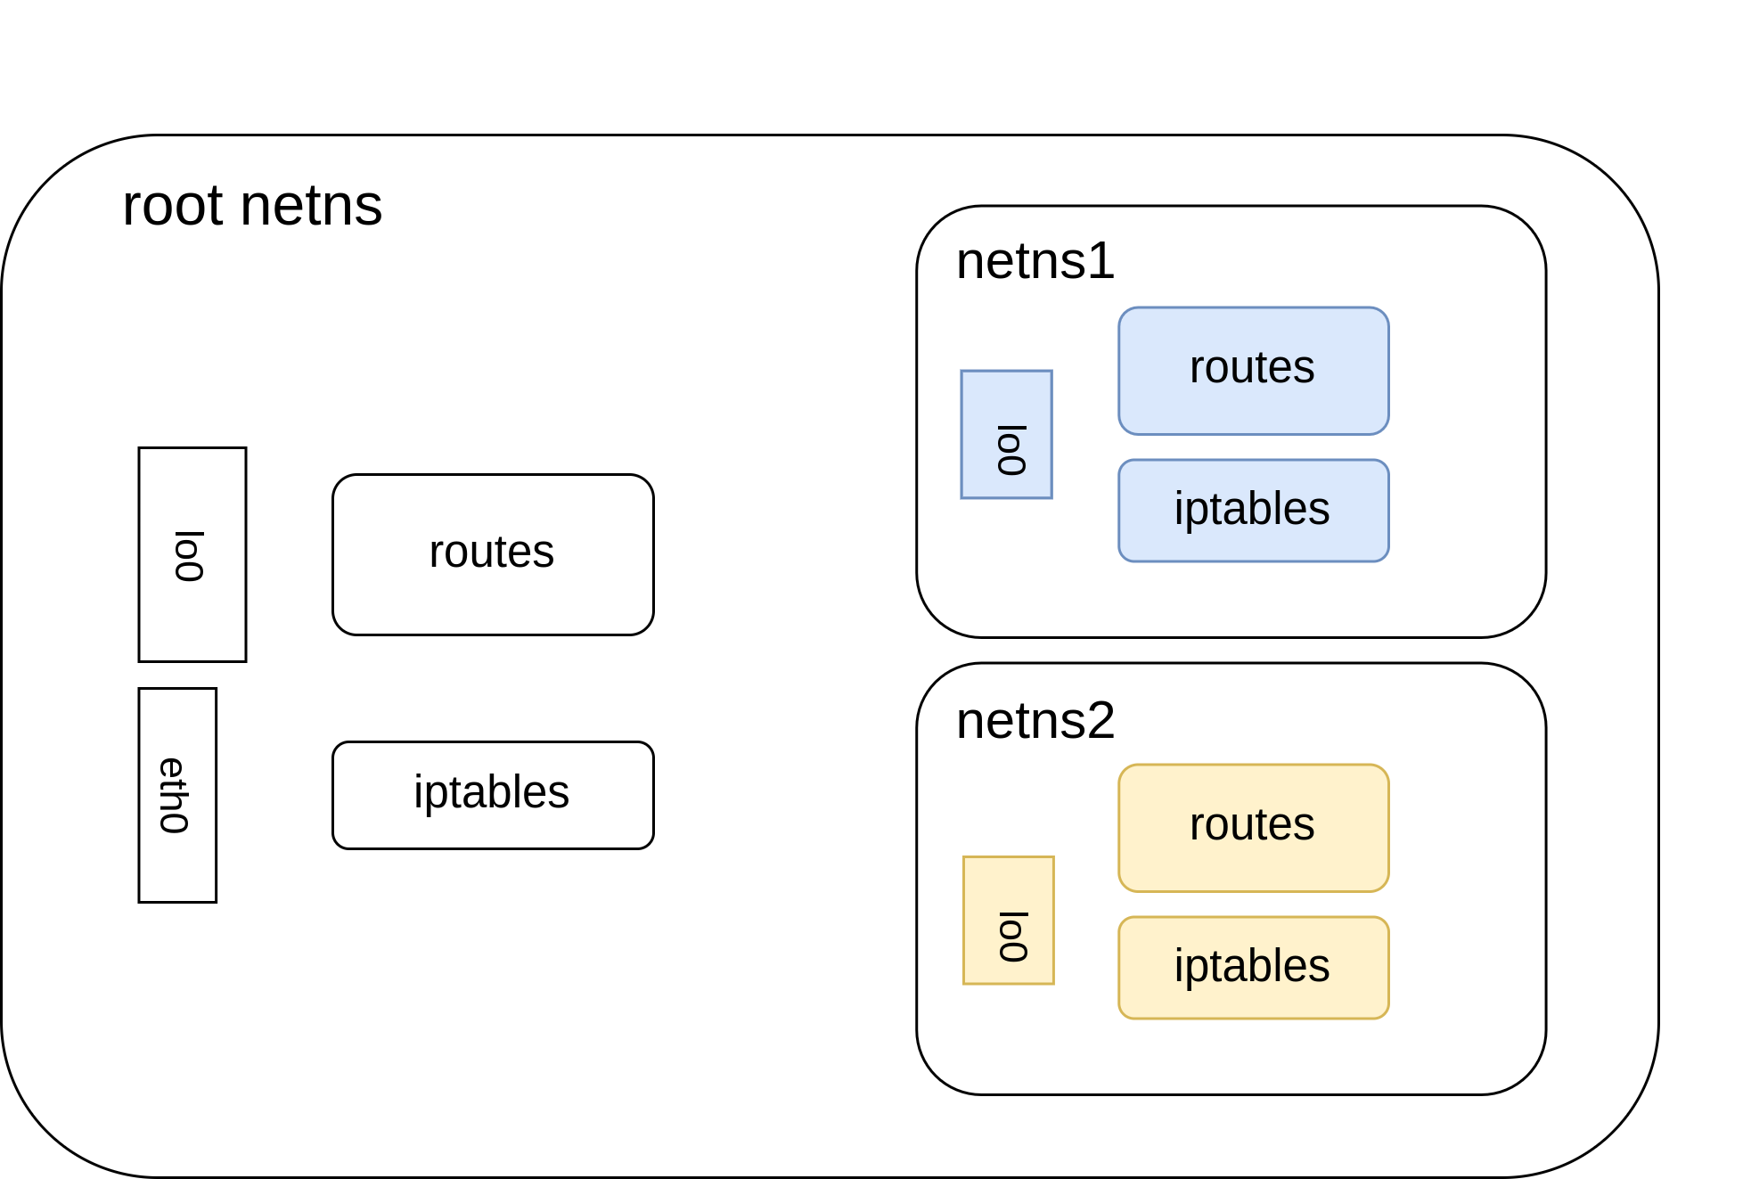
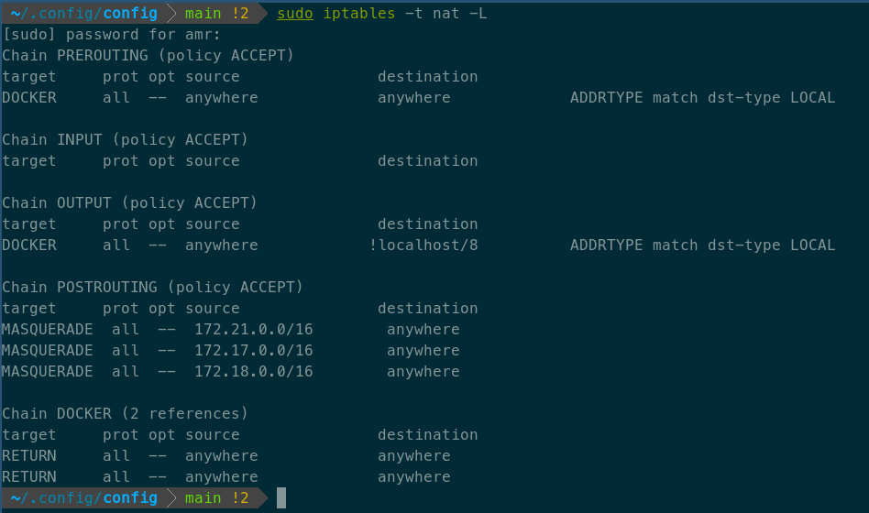
Theme of the talk
Explain some concept
Show a live demo

Slide 7
OSI

Slide 8
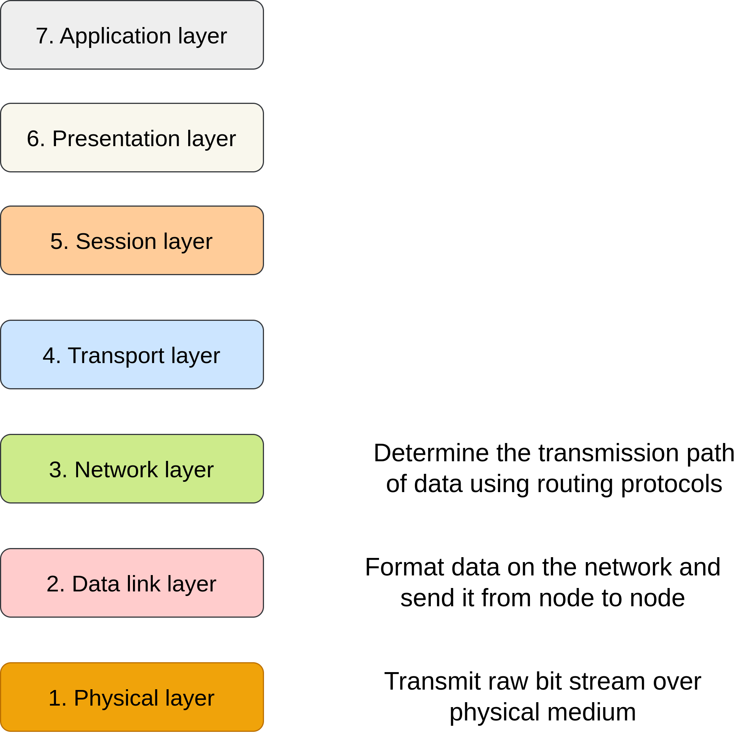
The Open Systems Interconnection (OSI Model)
Model from the International Organization for Standardization (ISO)
Create standards for system interconnection
7 layers computers can use to communicate over network
Interesting for us: L2,L3

Slide 9
NIC

Slide 10
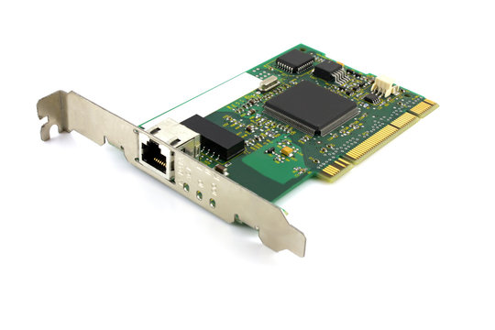
Network interface controller (NIC)
Hardware device connecting a computer to a network
Connection is either through cable or wireless
Has a unique mac address assigned by manufacturer
Can have an IP address

Slide 11
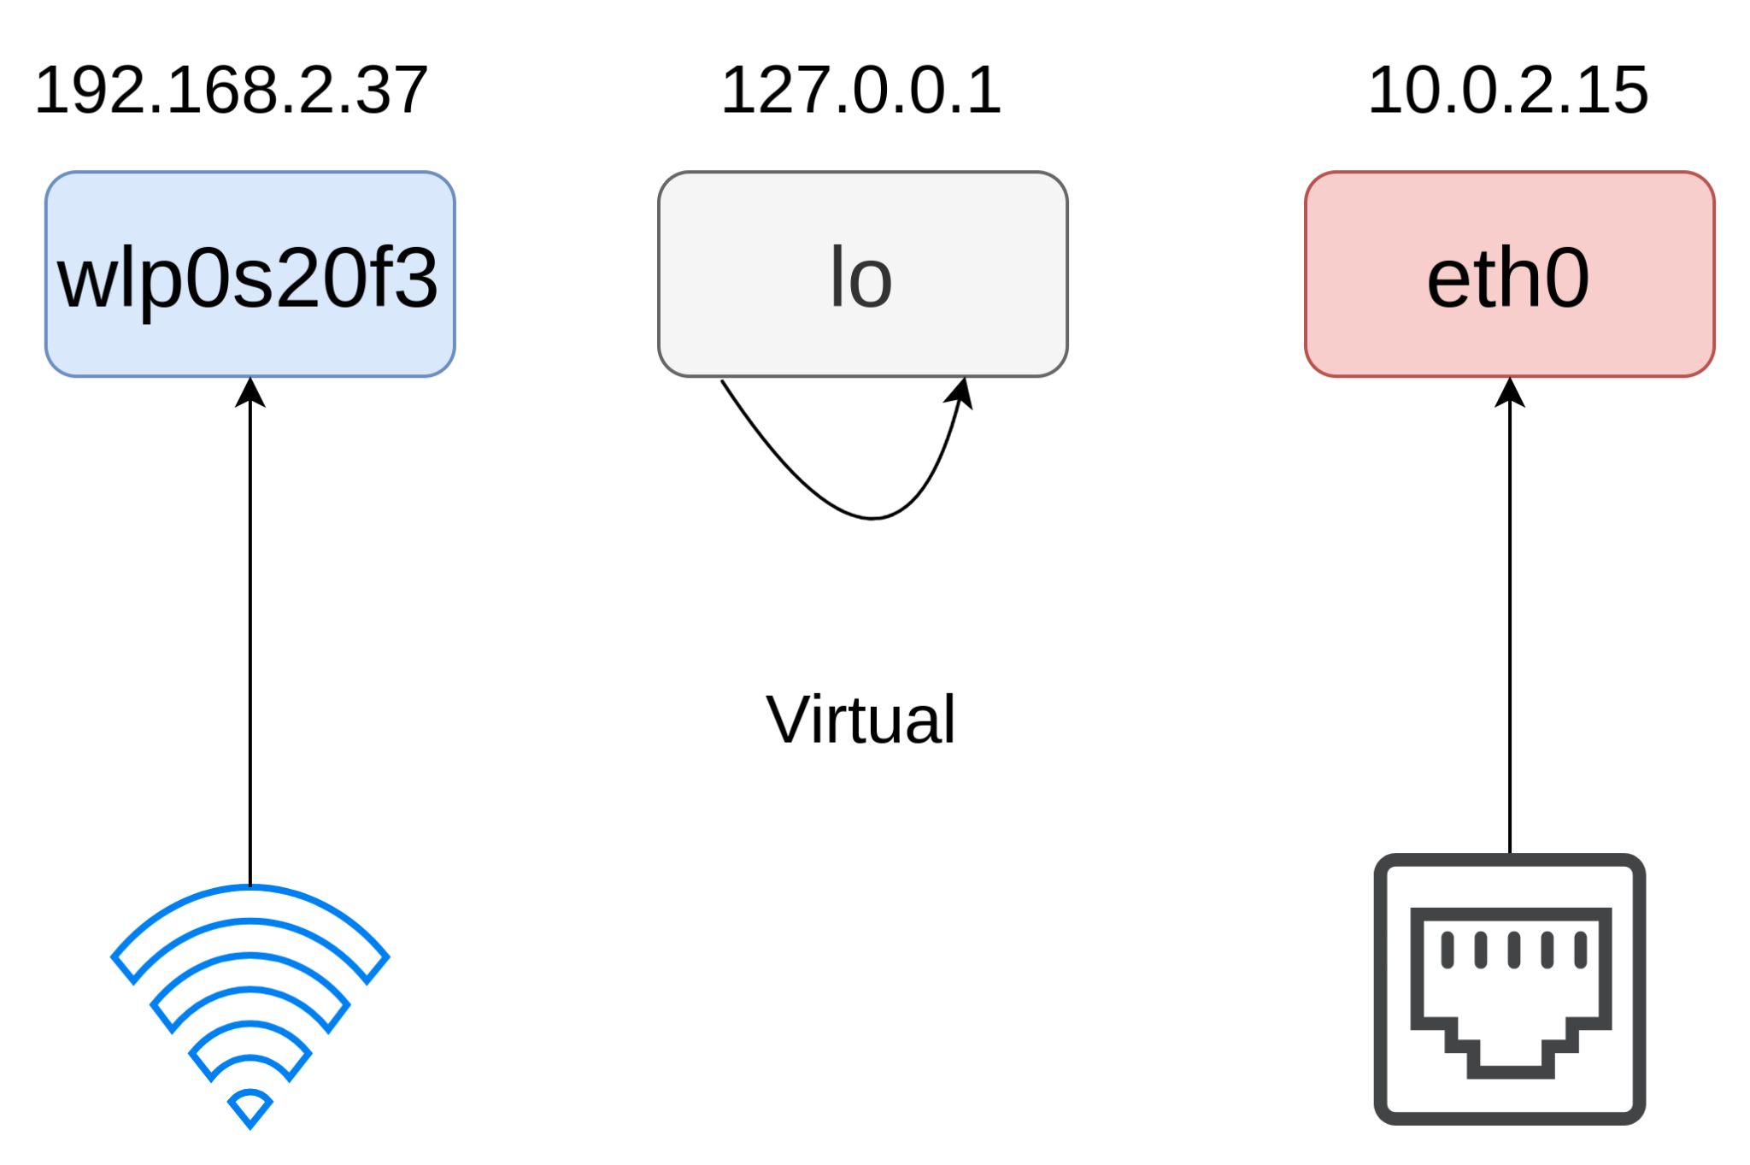
Linux network interface
Link between software side of networking and hardware side
Can be associated with a NIC
Can be virtual
Enables the kernel to talk to the NIC

Slide 12
Routing

Slide 13
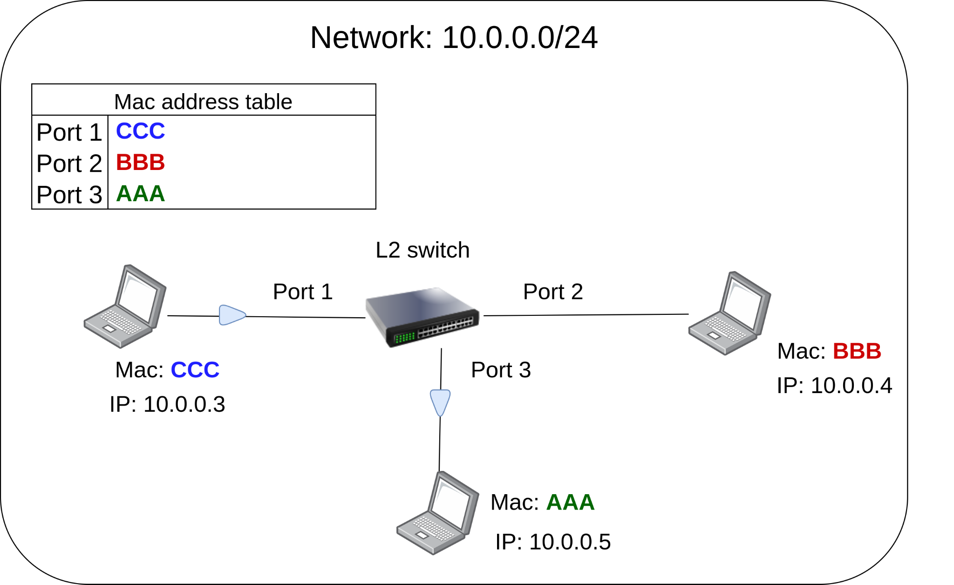
L2 switches
A L2 switch forwards packets based on mac address
Mac address uniquely identifies a network device in a network
Mac address table: maps a port to a mac address
Enables connectivity in a local area network LAN
Assumption: we know the mac address

Slide 14
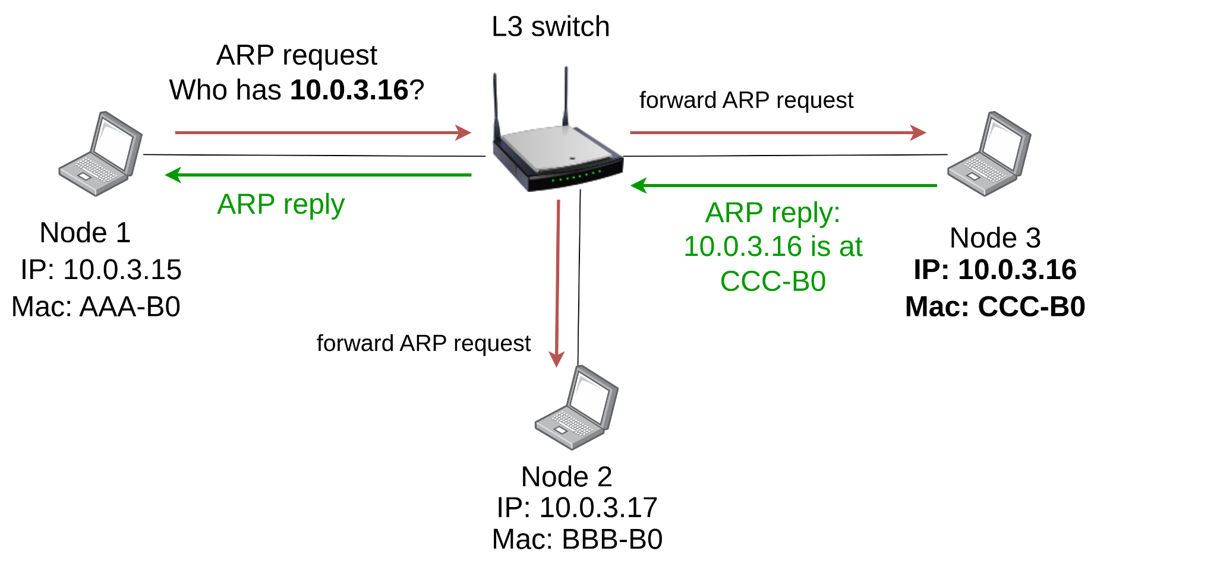
L3 switches: ARP
IP address known, mac address unknown
Address resolution protocol ARP
Get mac address for a certain IP address
ARP request: Broadcast who has mac for ip …?
ARP reply: ip … ist at this mac …
L3 switches understand IPs
Network 10.0.3.0/24

Slide 15
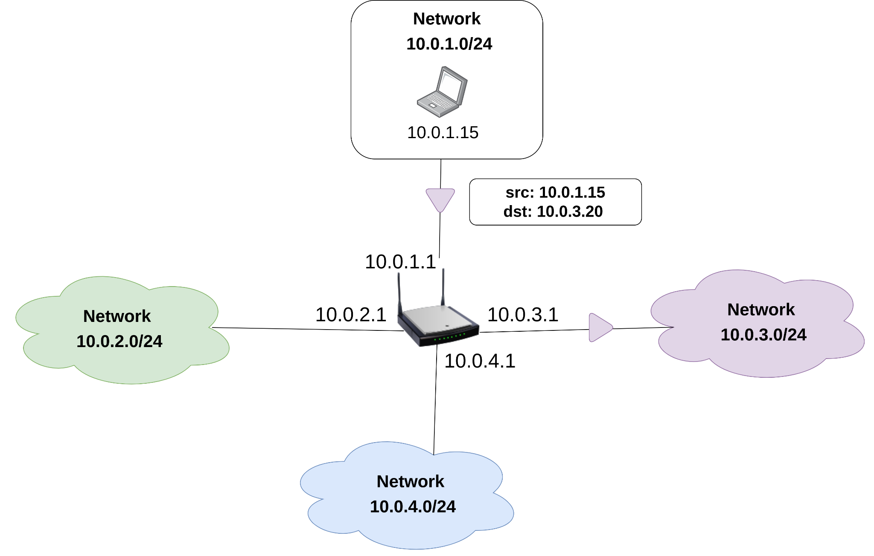
Routing
A router connects at least 2 networks
Each interface is in different network
Which interface should be used to deliver packets?

Slide 16

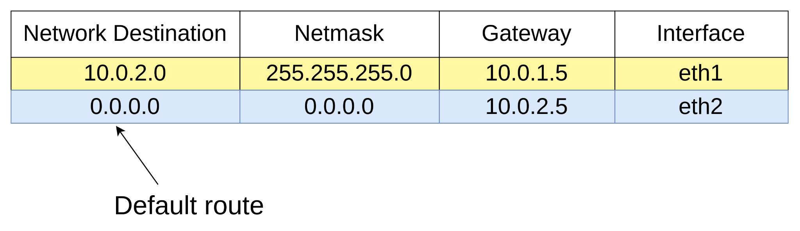
Routing table
Decide next path for packets to reach the destination
Components
Network destination + Netmask: Define the network
Next hop/Gateway: next immediate router in the path to reach the destination
Interface: Outgoing interface used to talk to the gateway
Default route: The route used when no match is found
10.0.2.0/24

Slide 17
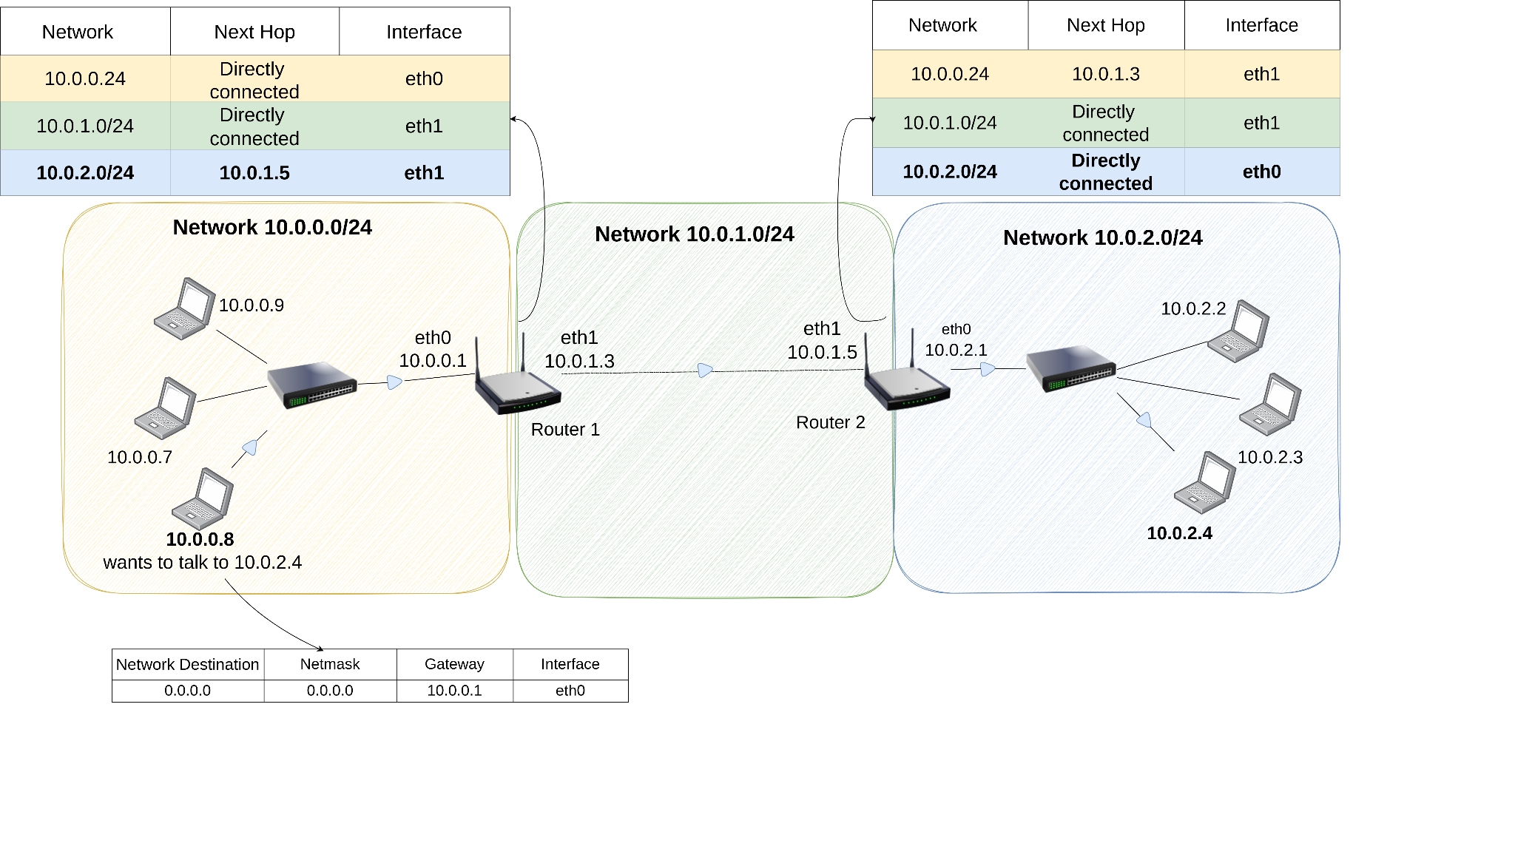
L3 routing
Routers exchange network information with e.g BGP

Slide 18
NAT

Slide 19
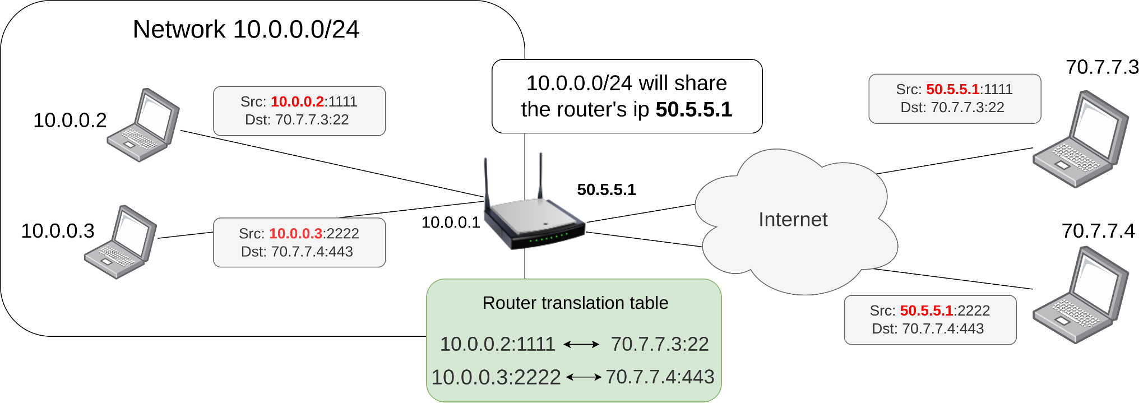
Network address translation NAT
Map multiple private addresses to a public address

Slide 20
Agenda
Some basics ✅
OSI ✅
NIC ✅
Routing ✅
NAT ✅
IPTABLES
Network namespaces
Veth pairs
Virtual bridges
K8s
Architecture
Pod to Pod networking
Service networking
DNS

Slide 21
IPTABLES

Slide 22
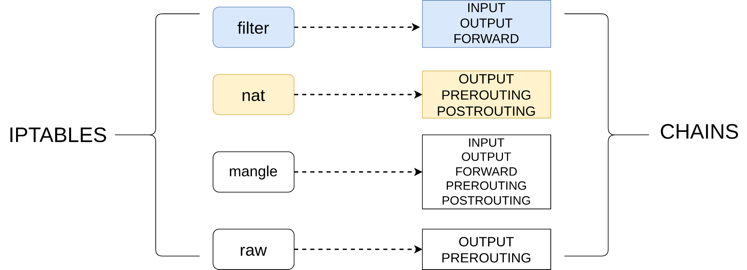
IPTABLES: What does it do?
Administration tool for IP packet filtering and NAT rules in the Linux kernel
Tables contain built-in/user-defined chains
Each chain is a list of rules that can match packets
Each rule has a target specifying what to do with the packet
Built in targets
Accept: let packet through
Drop: ignore the packet
Jump: go to another chain
Return: stop traversing this chain

Slide 23
IPTABLES: the tables
Filter: used to filter packets
Suitable for Firewall rules
Nat: used when packet creates a new connection
Used for network address translation
Mangle: special packet altering
Raw: configures exemptions from connection tracking

Slide 24
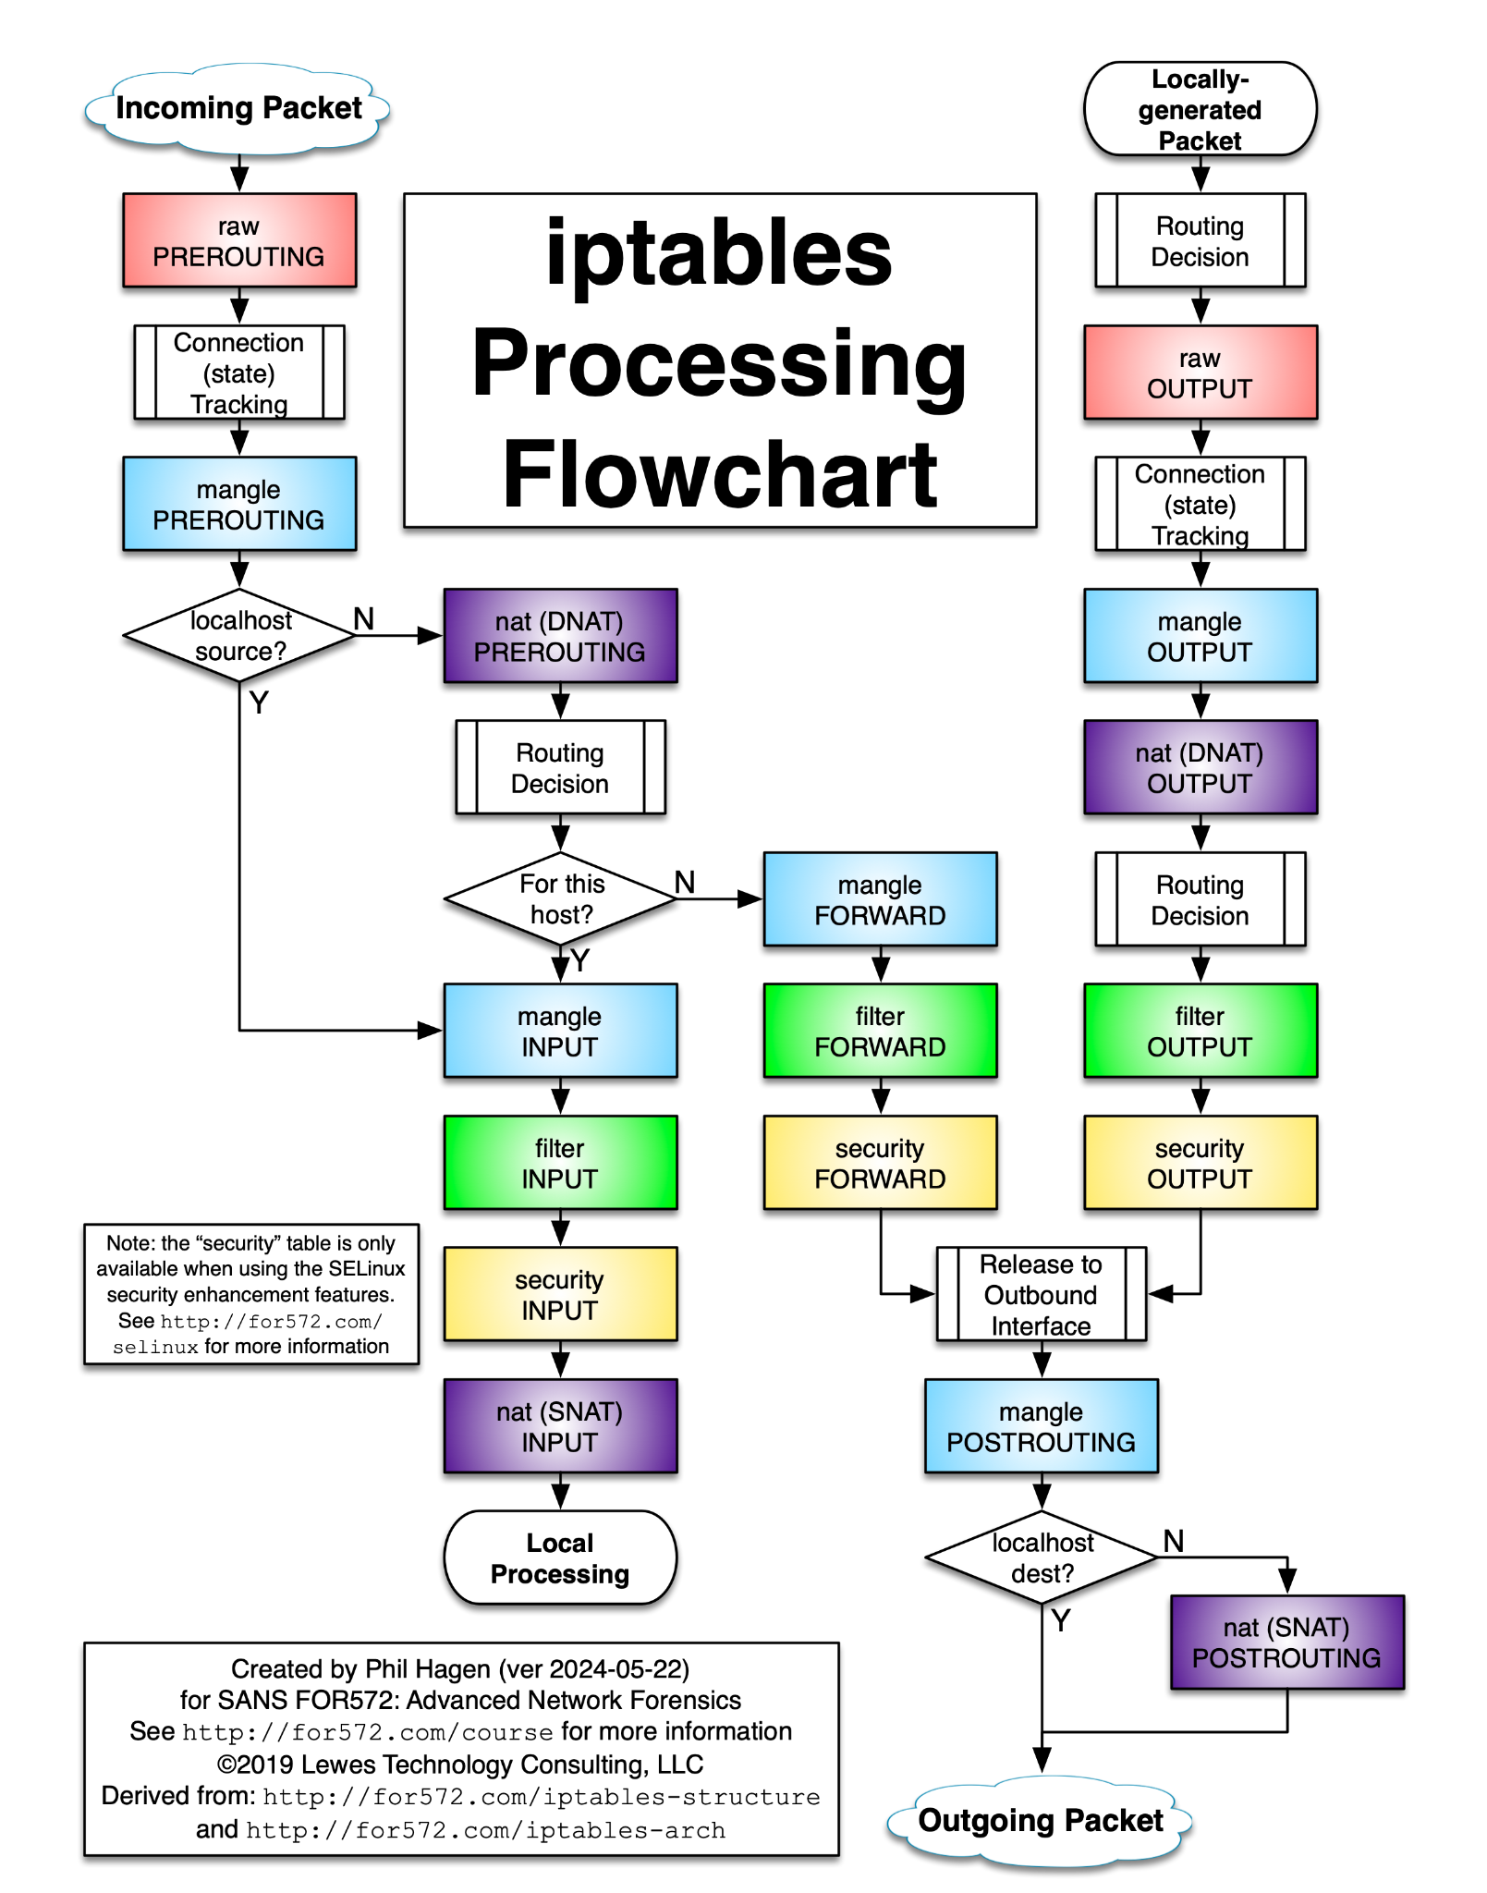
IPTABLES packet flow

Slide 25
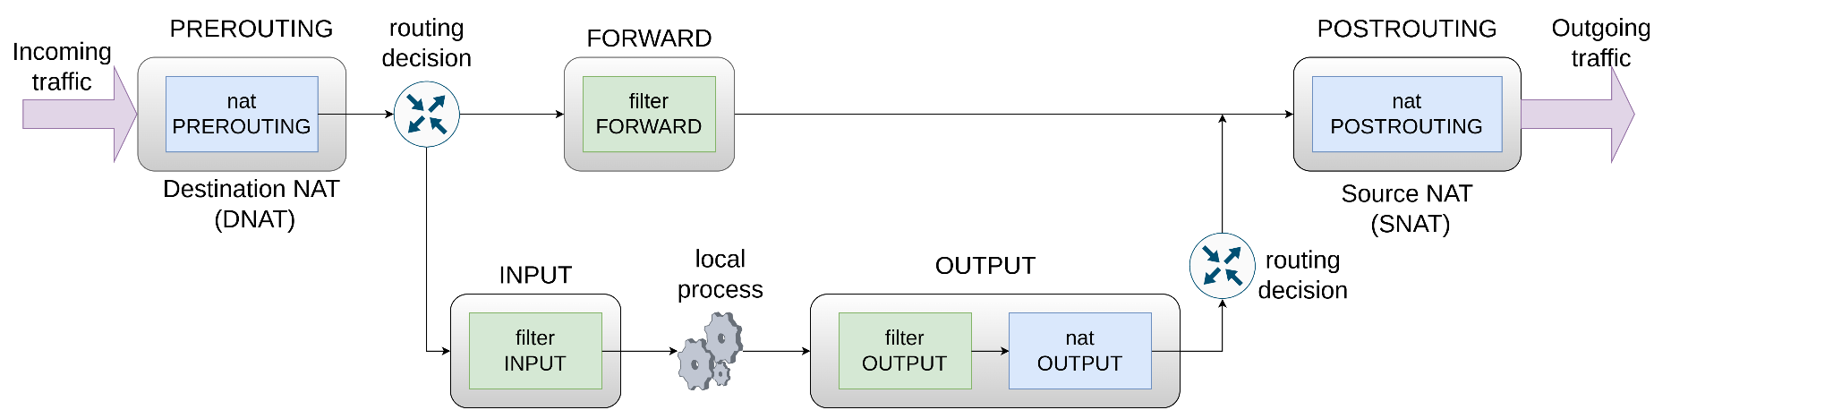
IPTABLES packet flow
PREROUTING: alter packets as soon as they reach the host
POSTROUTING: alter packets before they leave the host
INPUT: alter packets destined for local processes
OUTPUT: alter packets generated by local processes
FORWARD: alter packets forwarded by the host

Slide 26
IPTABLES
Use Cases

Slide 27
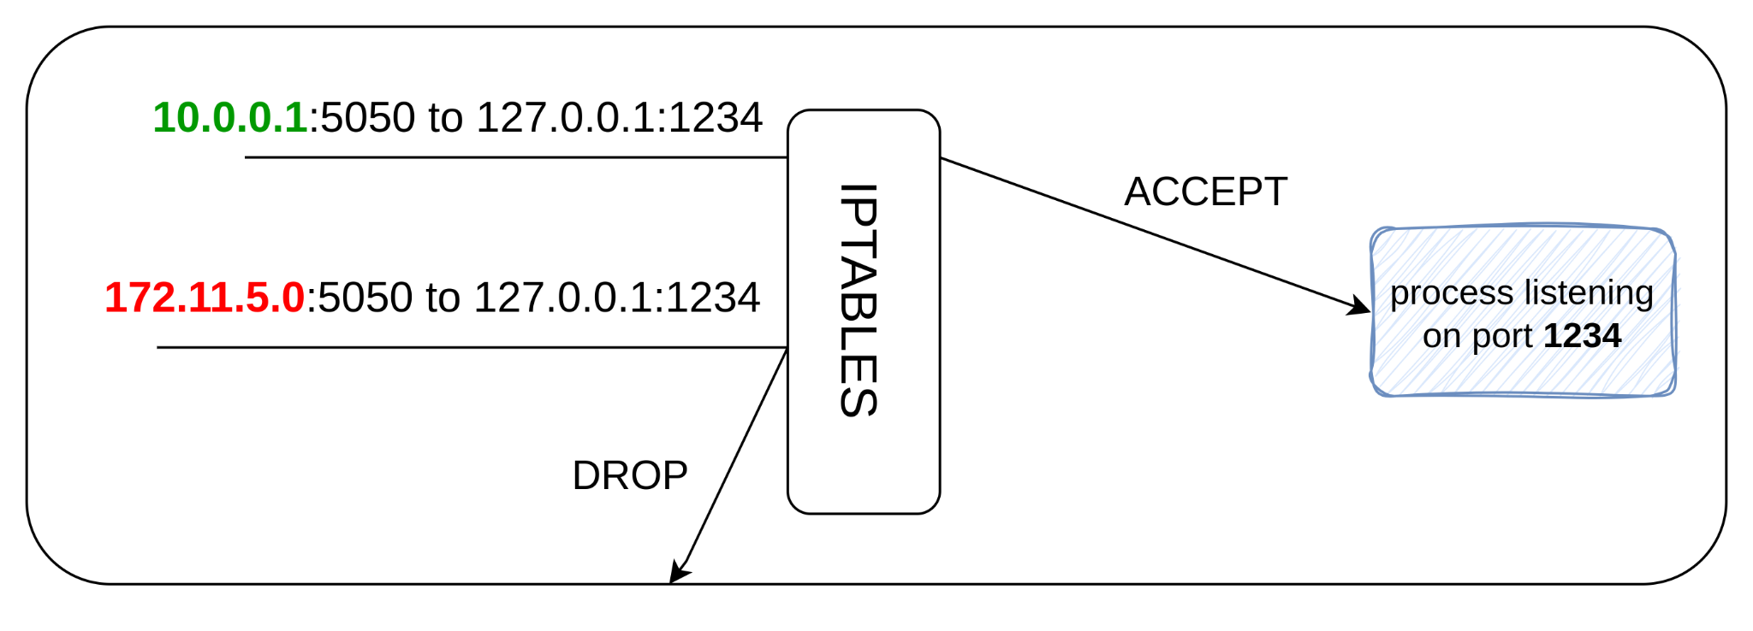
IPTABLES as a Firewall
Accept packets from 10.0.0.1
Reject otherwise (target DROP)

Slide 29
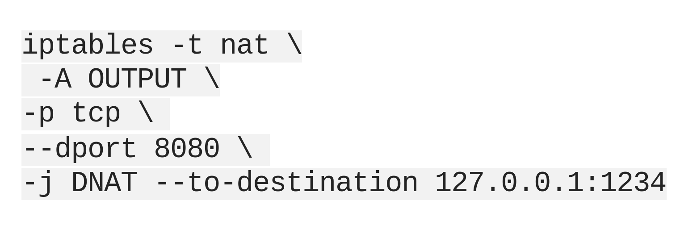
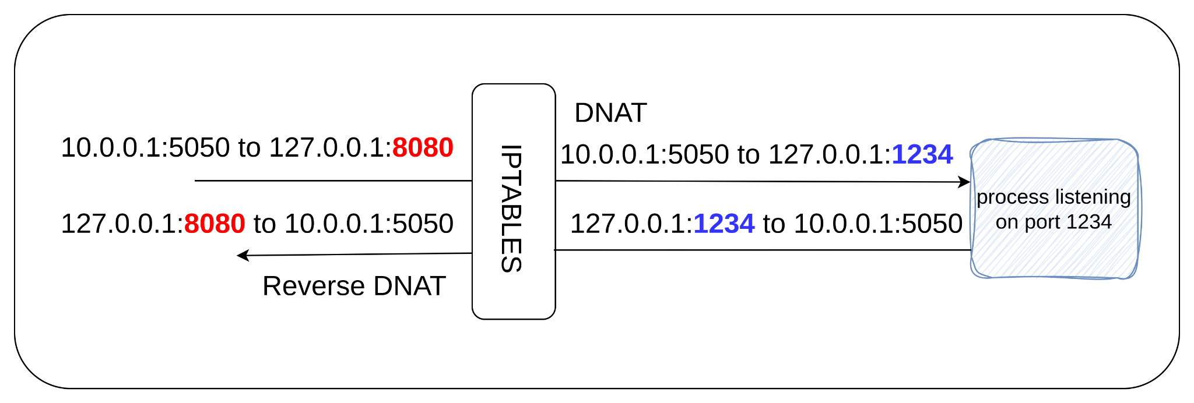
IPTABLES as NAT
OUTPUT chain (packet generated by a local process)
Change destination to 127.0.0.1:1234

Slide 31
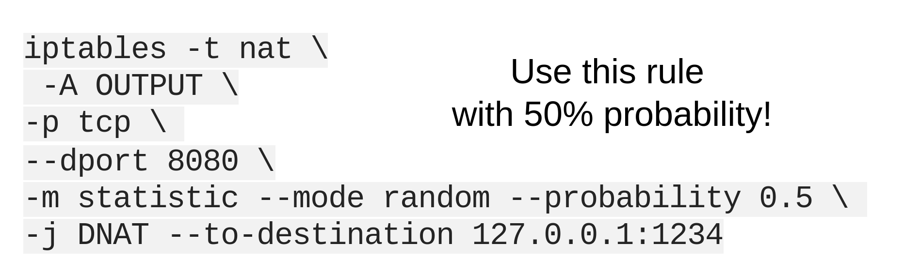
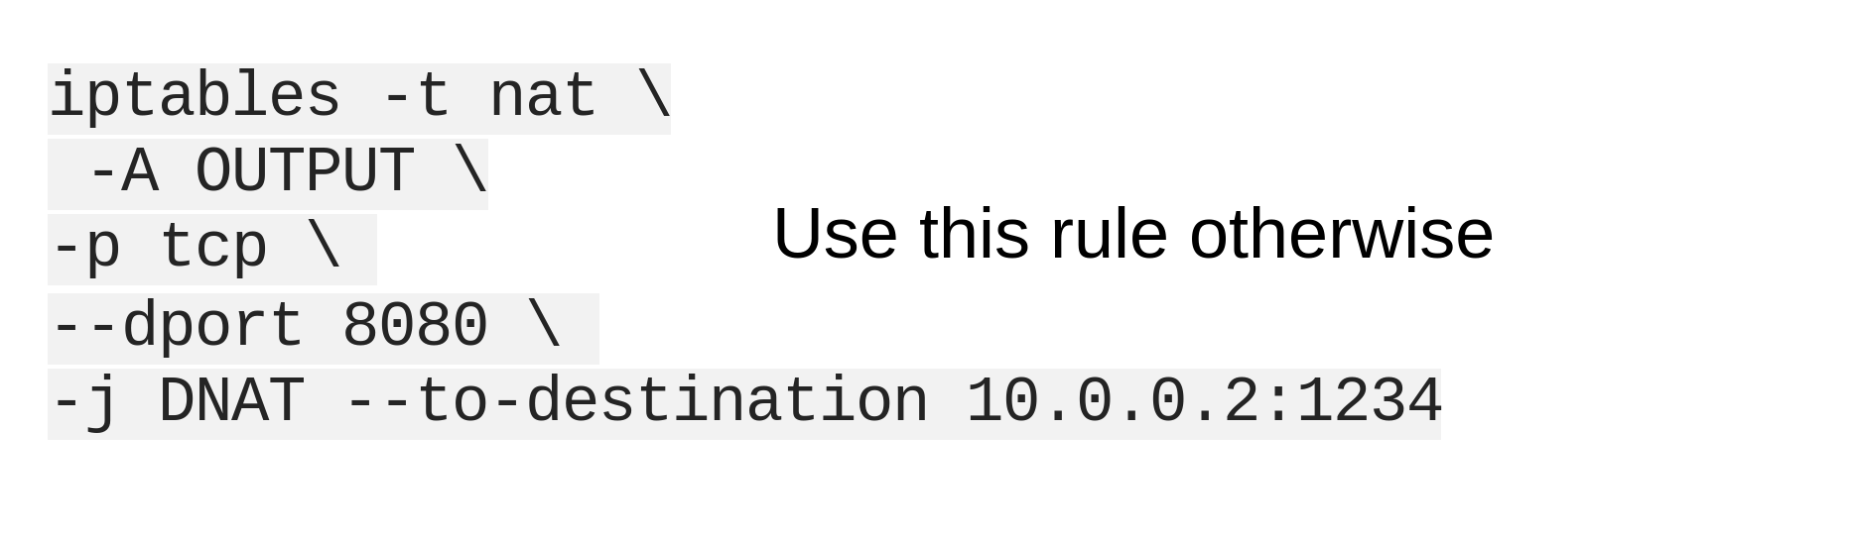
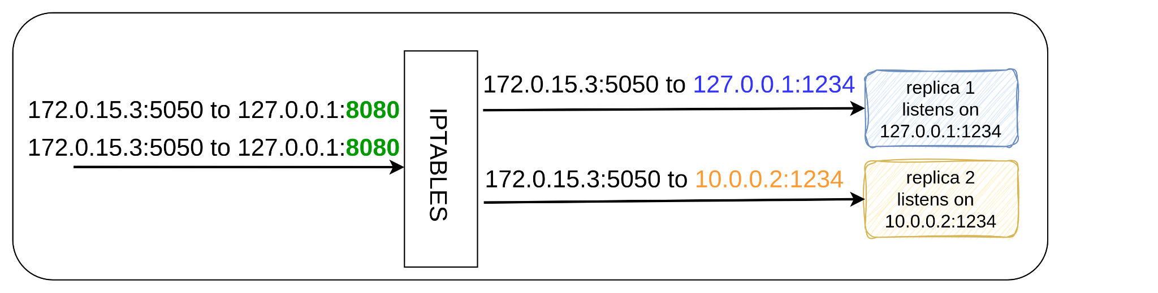
IPTABLES as Load Balancer
OUTPUT chain (packet coming from a local process)
Random probability load balancing
Match each rule with 50% chance

Slide 32
Agenda
Some basics ✅
OSI ✅
NIC ✅
Routing ✅
NAT ✅
IPTABLES ✅
Network namespaces
Veth pairs
Virtual bridges
K8s
Architecture
Pod to Pod networking
Service networking
DNS

Slide 33
Network namespaces

Slide 34
Linux namespaces
The linux manual says: “A namespace wraps a global system resource in an abstraction that makes it appear to the processes within the namespace that they have their own isolated instance of the global resource. Changes to the global resource are visible to other processes that are members of the namespace, but are invisible to other processes”
Example namespaces:
Cgroup
Virtualize the view of cgroups. Limit usage of resources
Mount
Isolation of mounts seen by processes. Processes in different mount namespace see different directory hierarchies
Network
Provide isolation of the system resources associated with networking
I.e: network devices, routing tables, firewall rules etc.

Slide 35
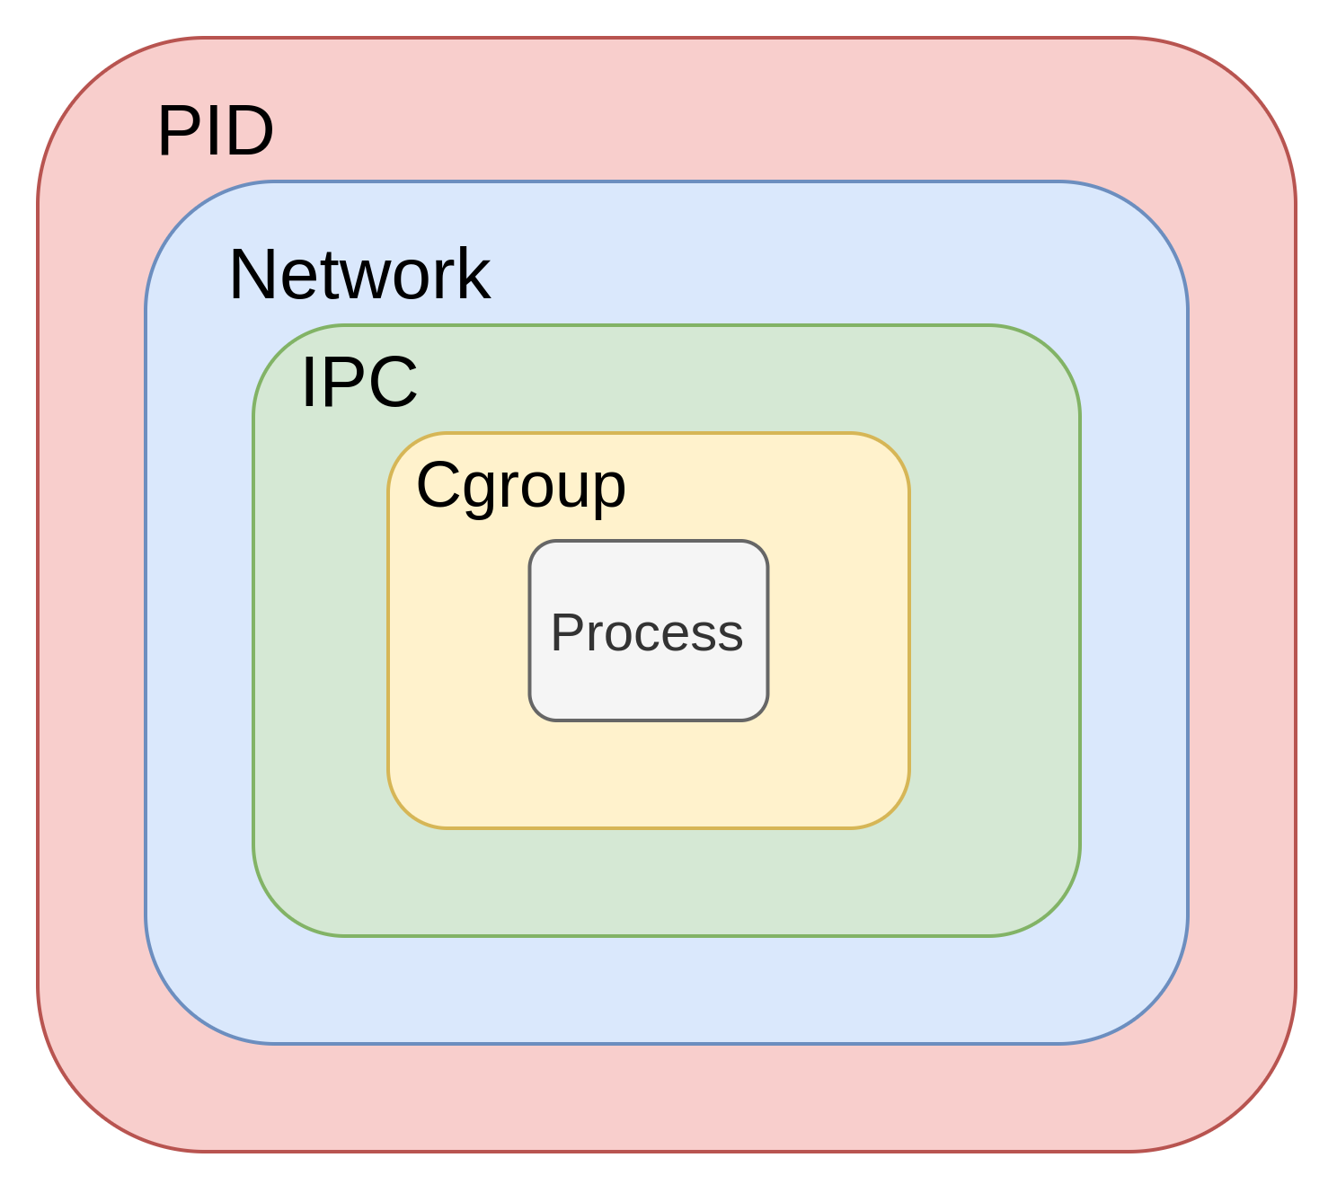
Linux namespaces
A container is a process inside of one or more namespaces

Slide 36
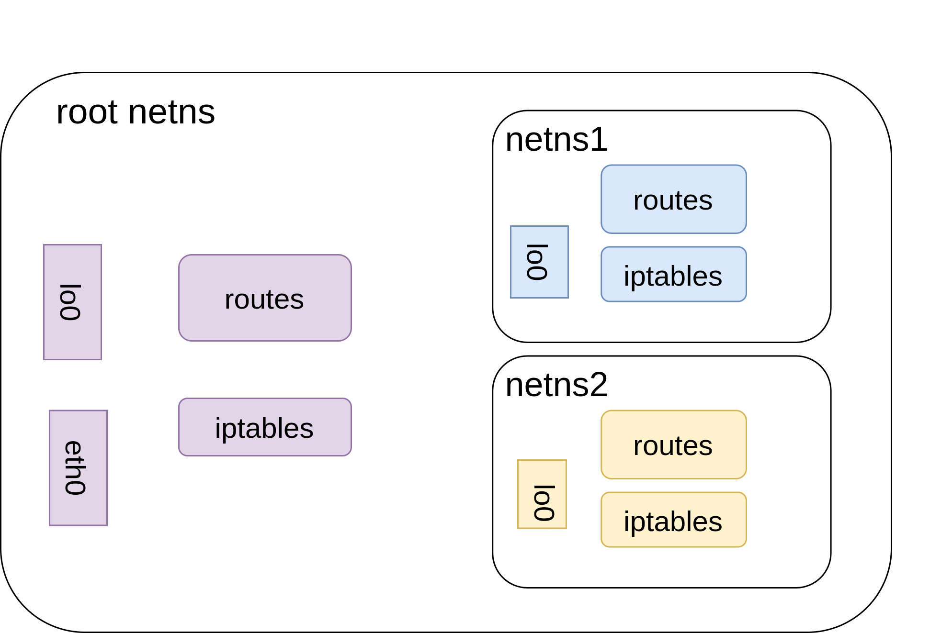
Isolated network namespaces
netns1 and netns2 have their own:
Routing tables
IPTABLES rules
Network devices/interfaces
Port numbers
Unreachable from the root ns (Isolation)

Slide 37
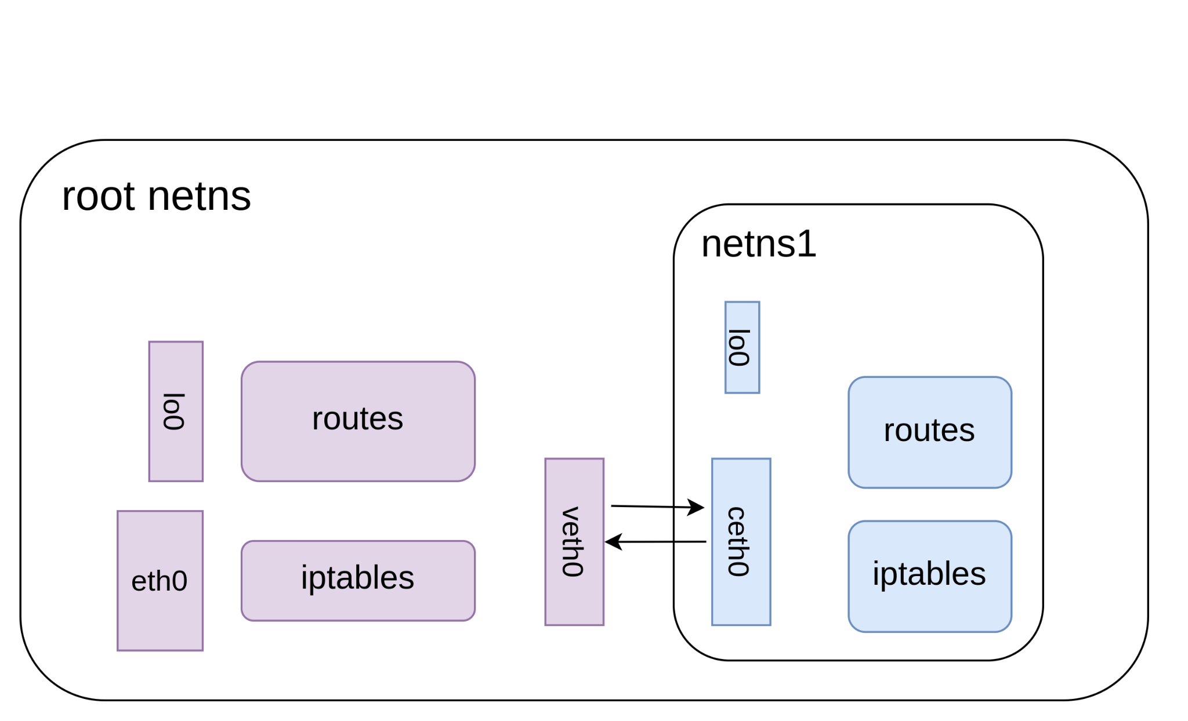
Virtual ethernet devices
Also called veth pairs
Tunnel between namespaces
Packets transmitted on one device are received in the other device

Slide 38
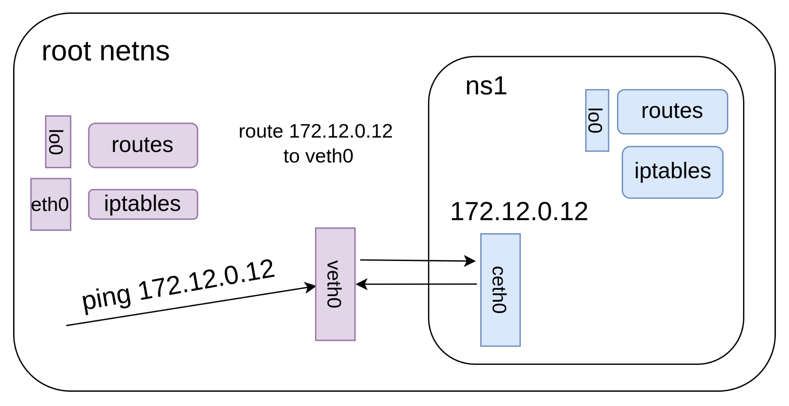
Virtual ethernet devices

Slide 39
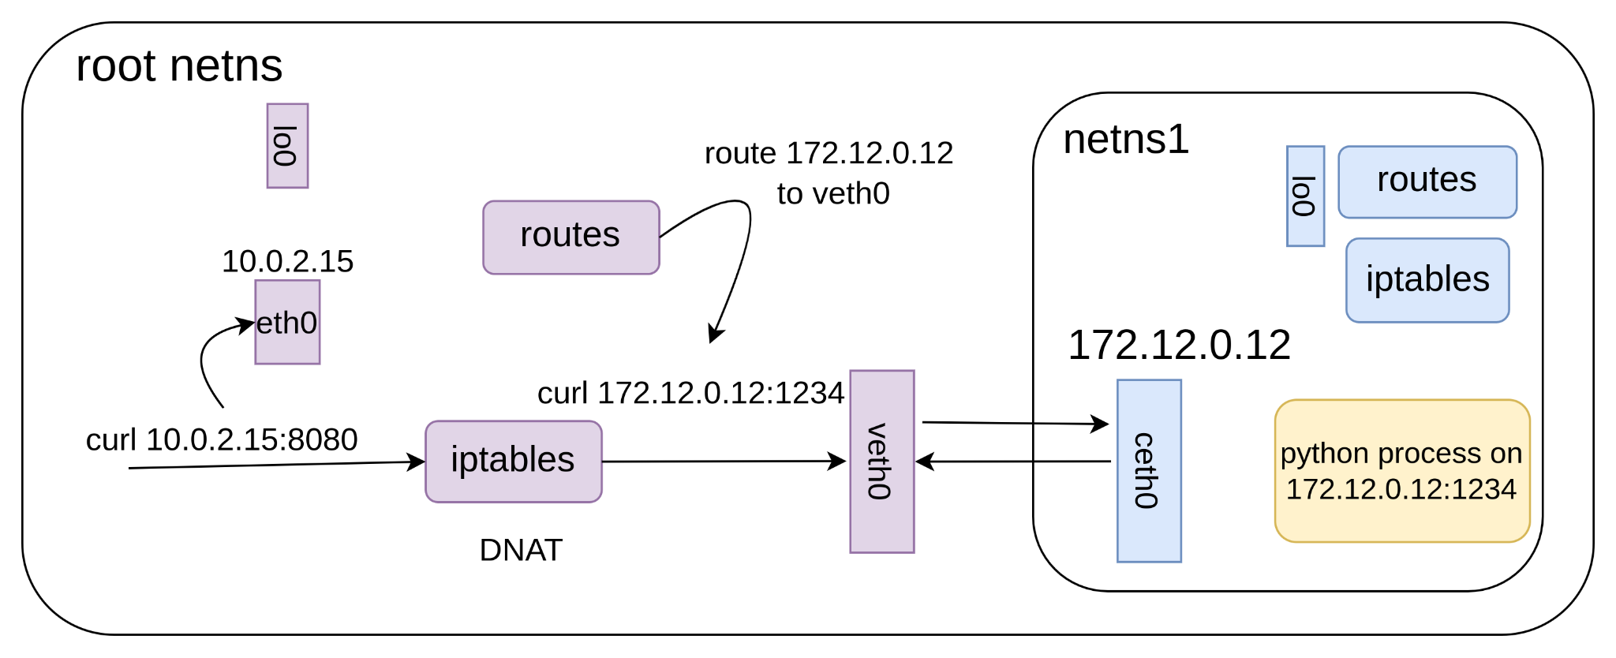
Port mapping: veth + iptables

Slide 40
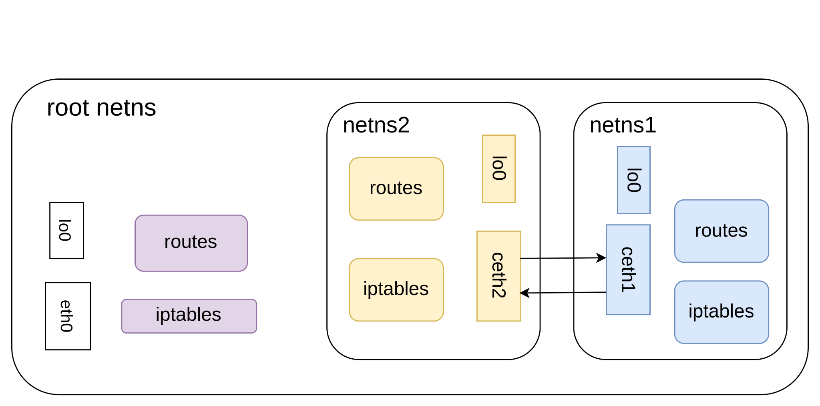
Connect 2 namespaces
One veth pair end in netns1
Other end in netns2
Classical way to connect namespaces
Does this scale??

Slide 41
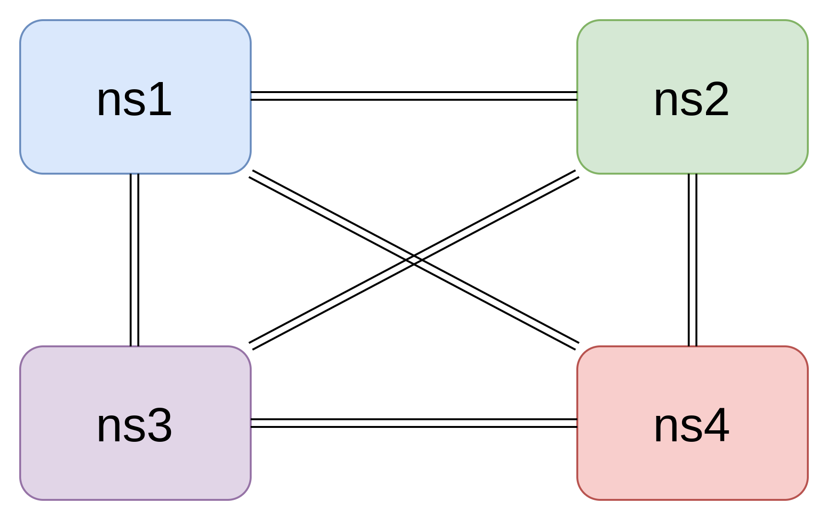
Connect 4 namespaces
For each new namespace, we need N-1 new veth pairs
Need a better approach!!

Slide 42
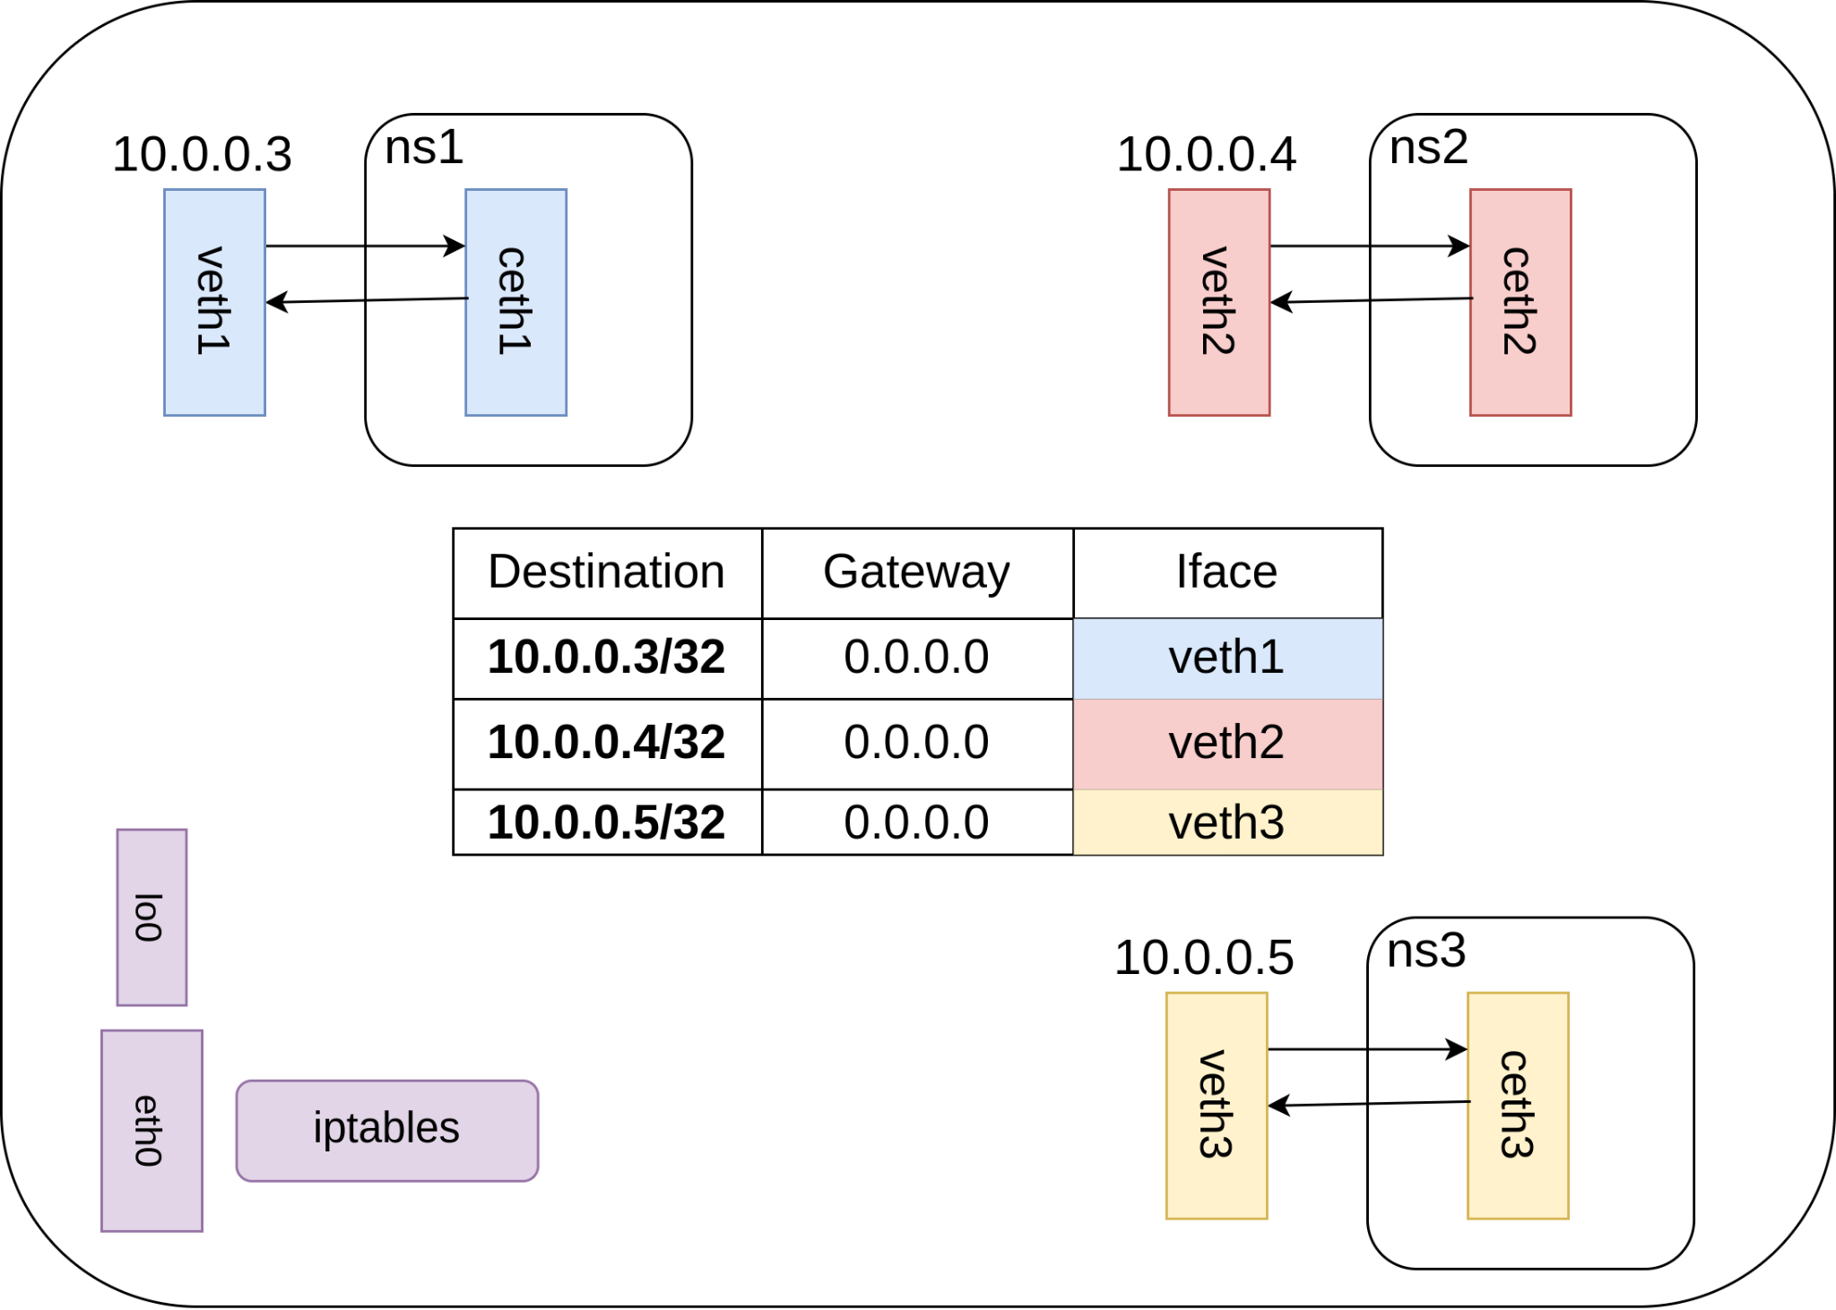
Connect multiple namespaces
Option 1: through routing table in the root namespace
Calico in k8s does this
Downsides??

Slide 43
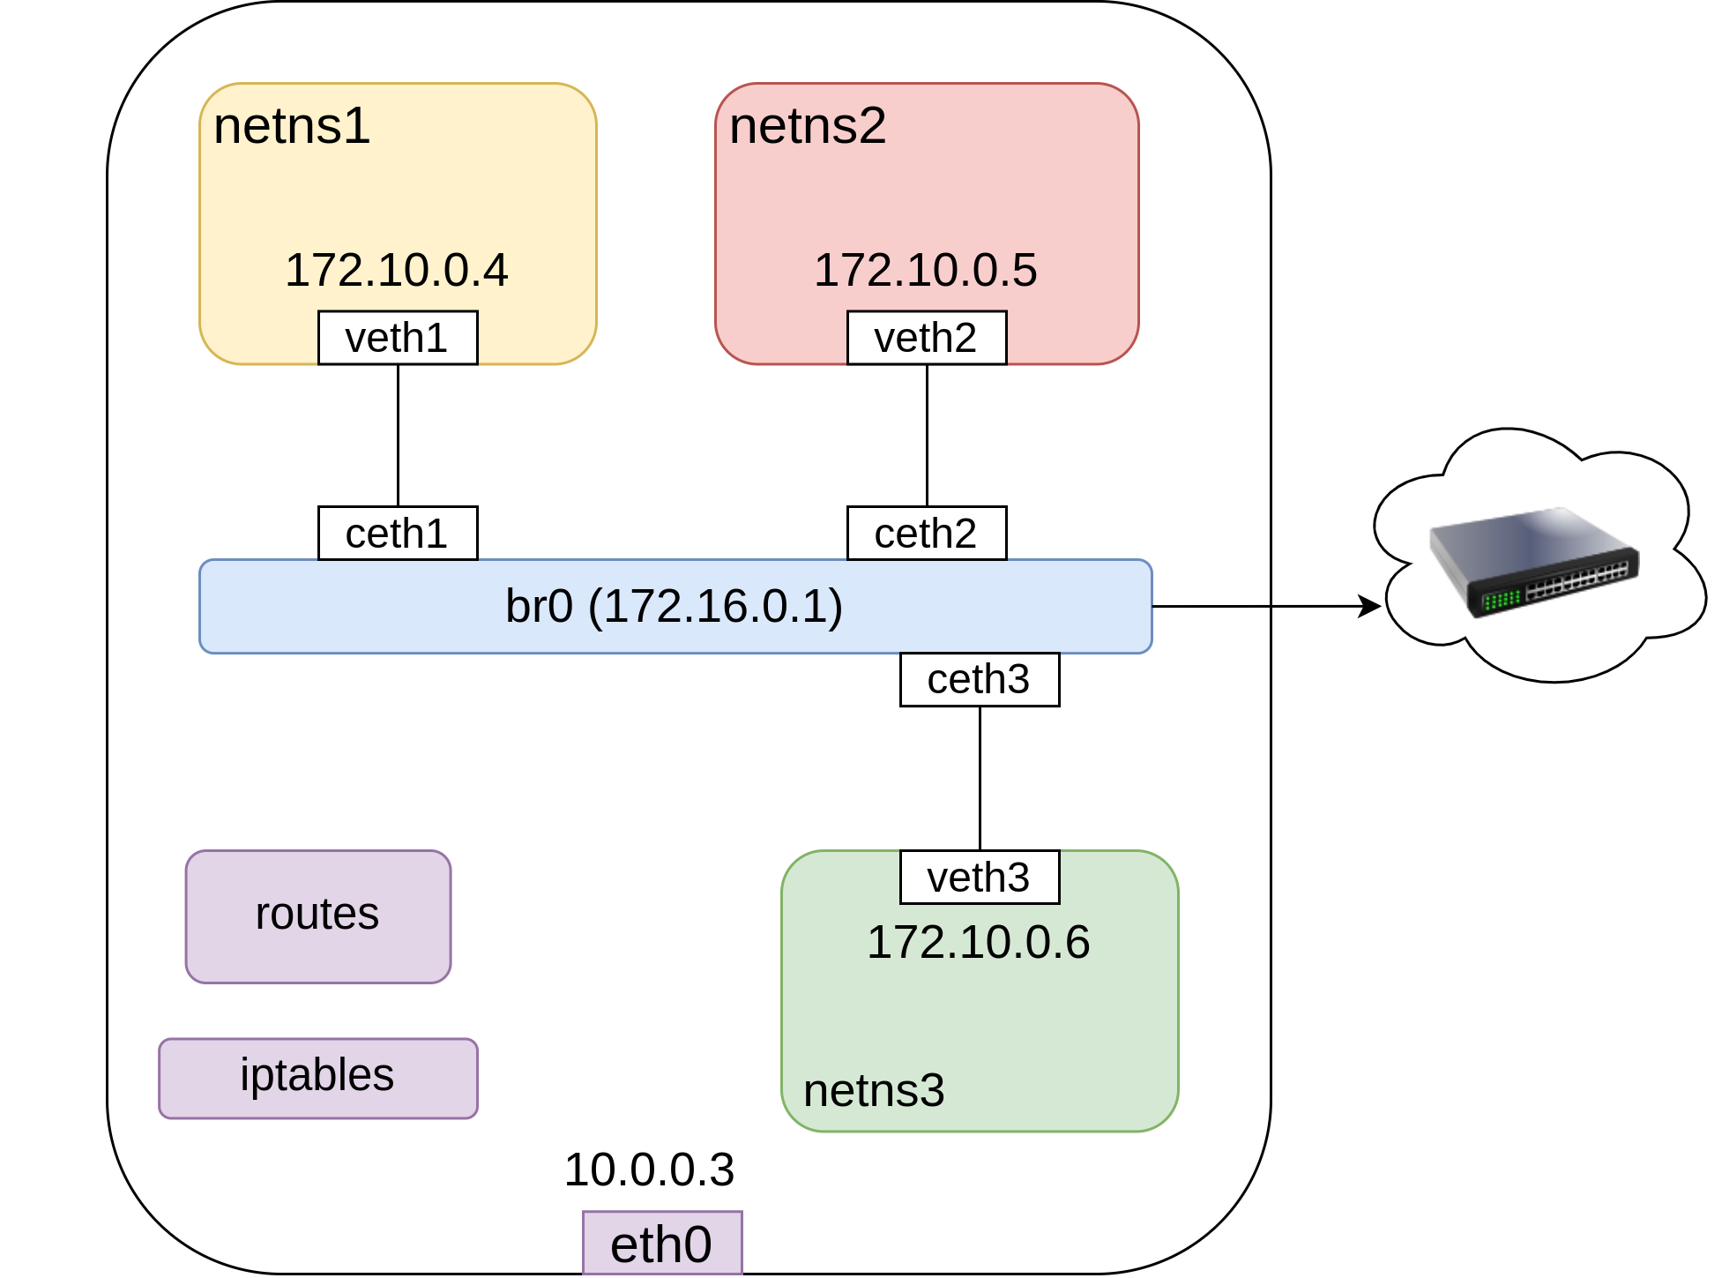
Connect multiple namespaces
Option 2: use a virtual bridge
Acts as L3 switch
Docker does this (default docker0) bridge

Slide 44
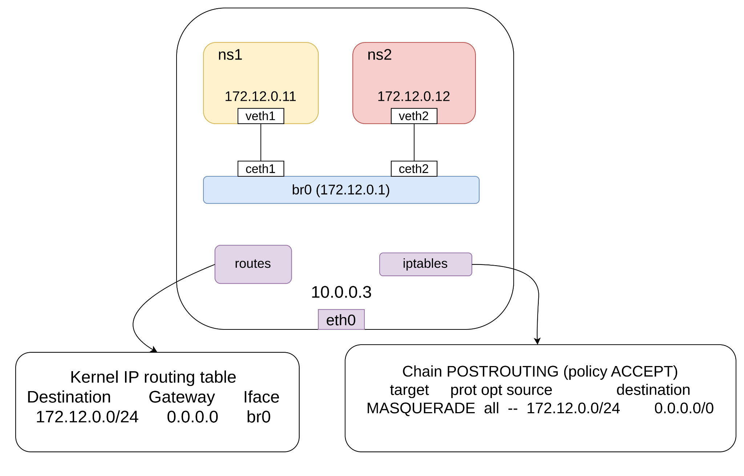
Connect multiple namespaces

Slide 45
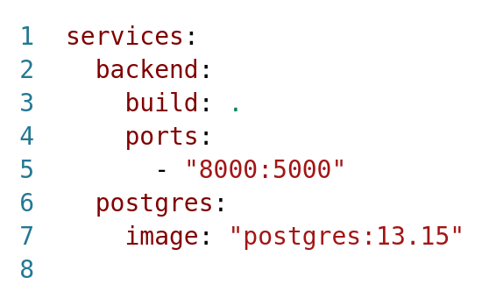
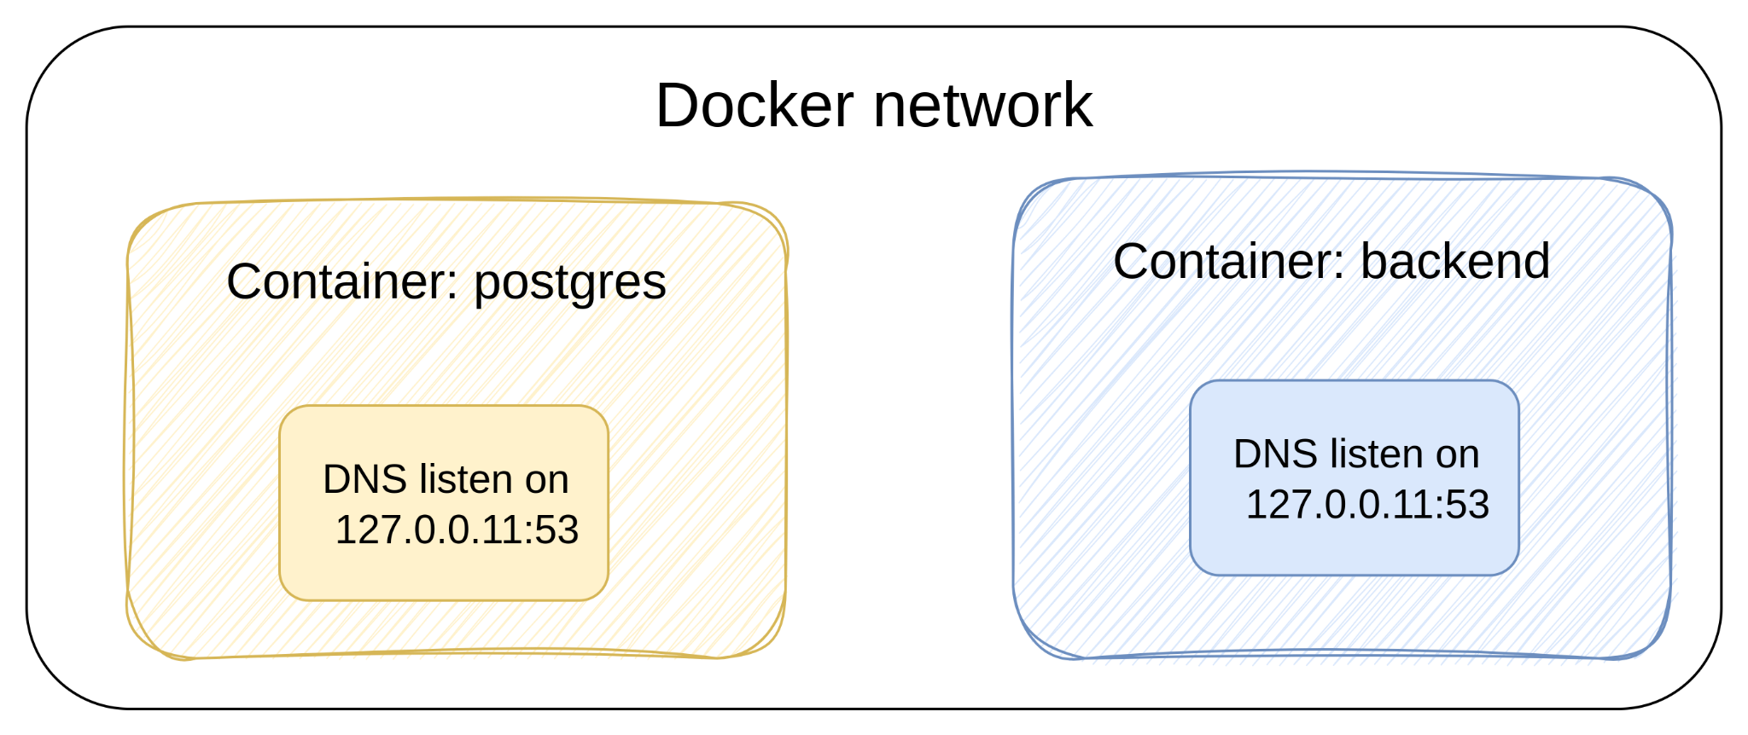
Docker DNS
DNS resolver inside each container

Slide 46
Agenda
Some basics ✅
OSI ✅
NIC ✅
Routing ✅
NAT ✅
IPTABLES ✅
Network namespaces ✅
Veth pairs ✅
Virtual bridges ✅
K8s
Architecture
Pod to Pod networking
Service networking
DNS

Slide 47
K8s

Slide 48
K8s: networking model
All pods have their own IPs
All pods can talk to all other pods
All nodes can talk to all pods
How to achieve these goals?

Slide 49
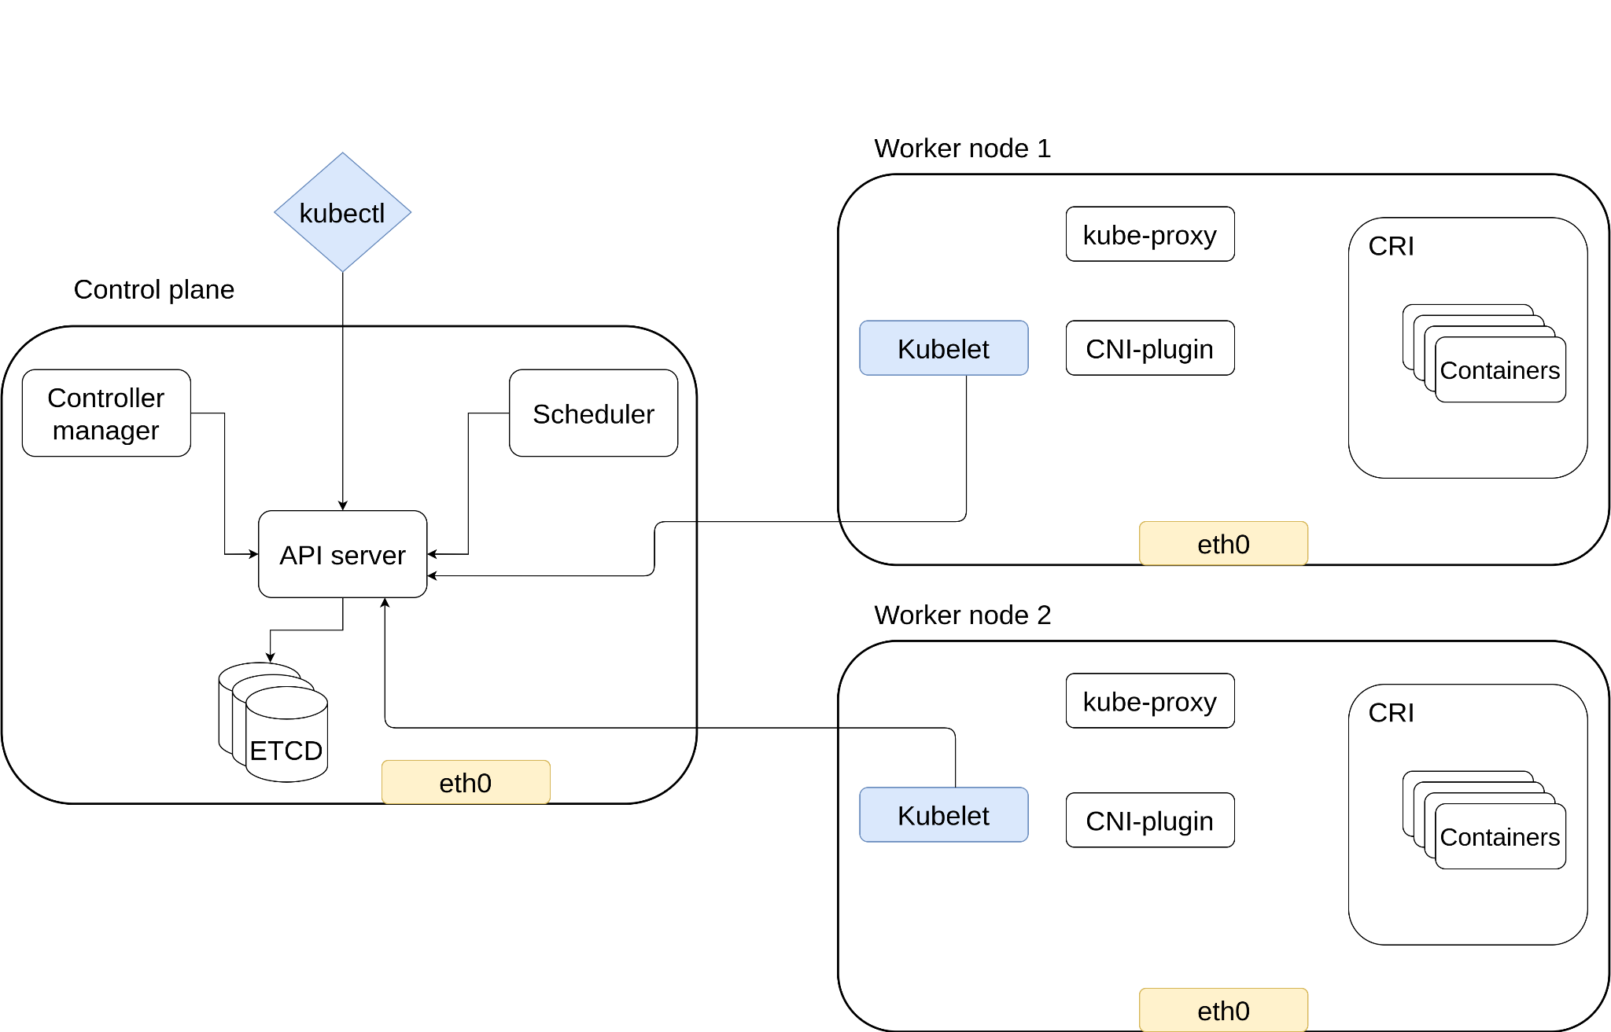
K8s architecture
kubelet: agent running on each node to create containers
controller manager: monitor the state of the cluster (current state, desired state)
kube-proxy: programs iptables on each node
CRI: container runtime interface (e.g Podman)
CNI-plugin: container network interface (e.g Calico)

Slide 50
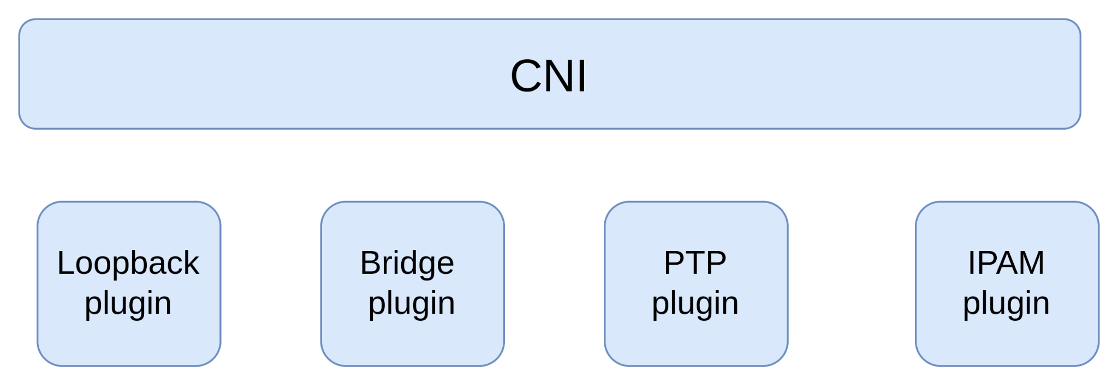
K8s: Container network interface CNI
Specification and libraries to write plugins
Plugins configure network resources
Manages network connectivity of containers
Provide Pods with IP addresses
Delete network resources when pods are deleted
E.g: Flannel and Calico

Slide 51
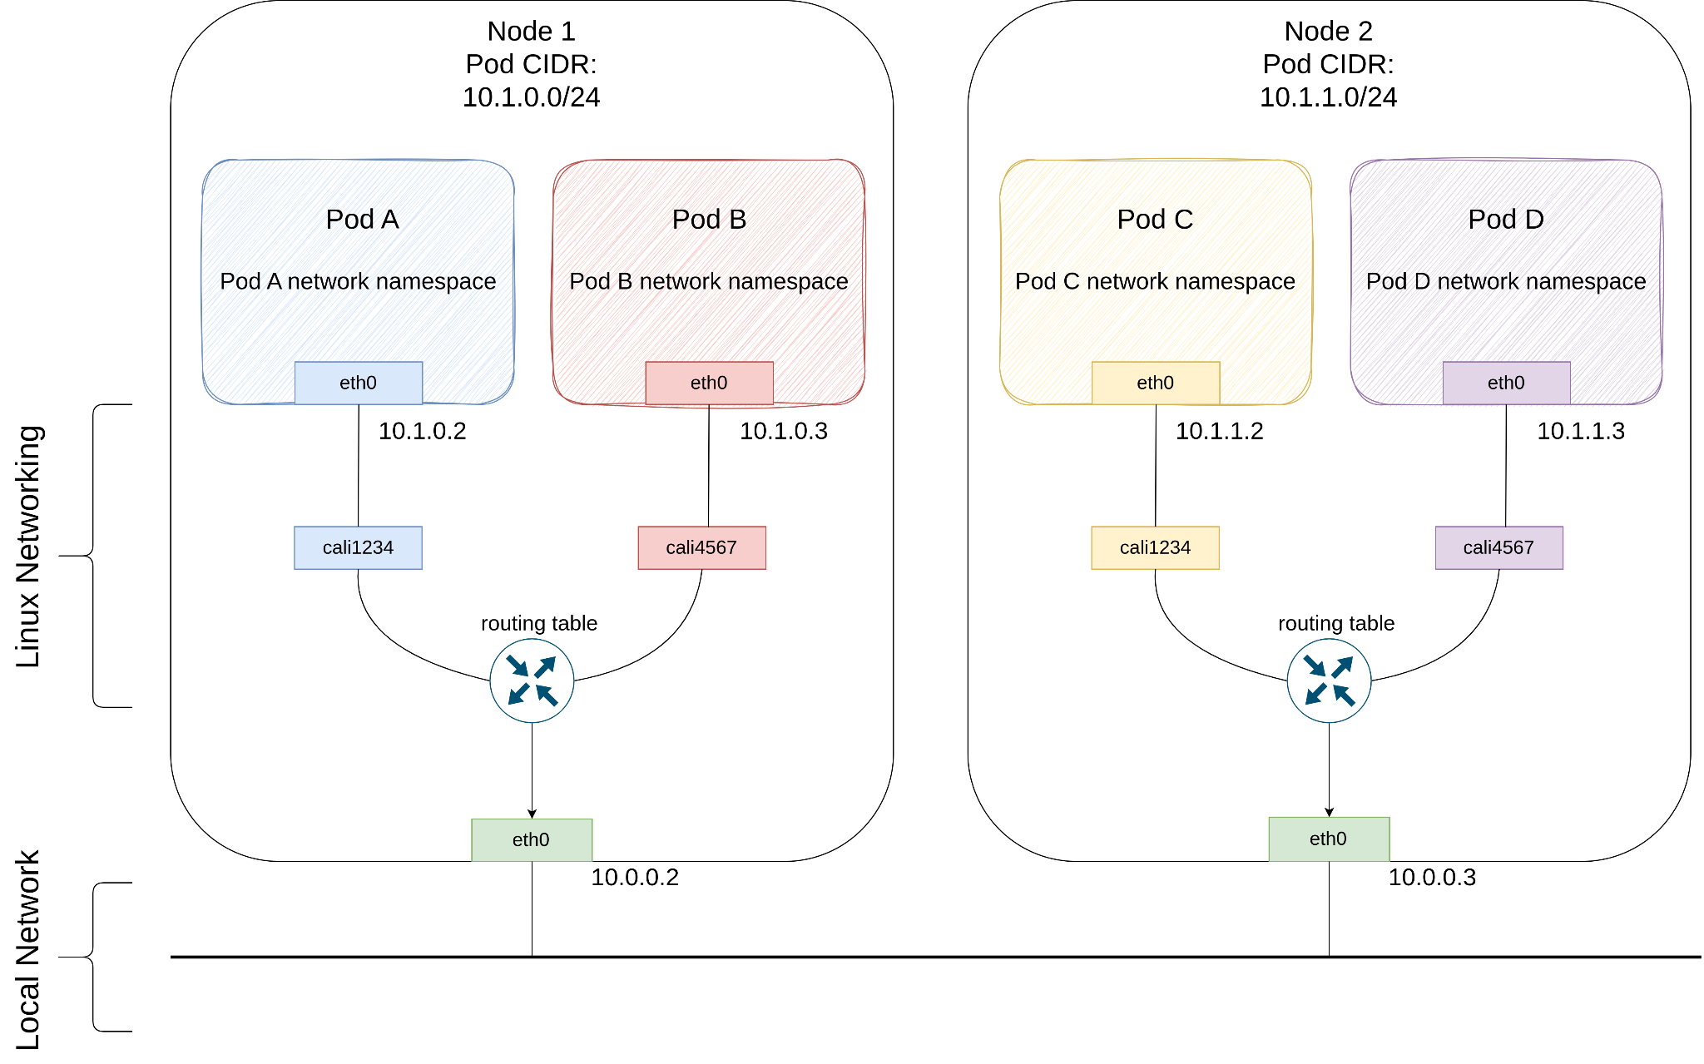
K8s networking
Goal: pod-to-pod and pod-to-service connectivity

Slide 52
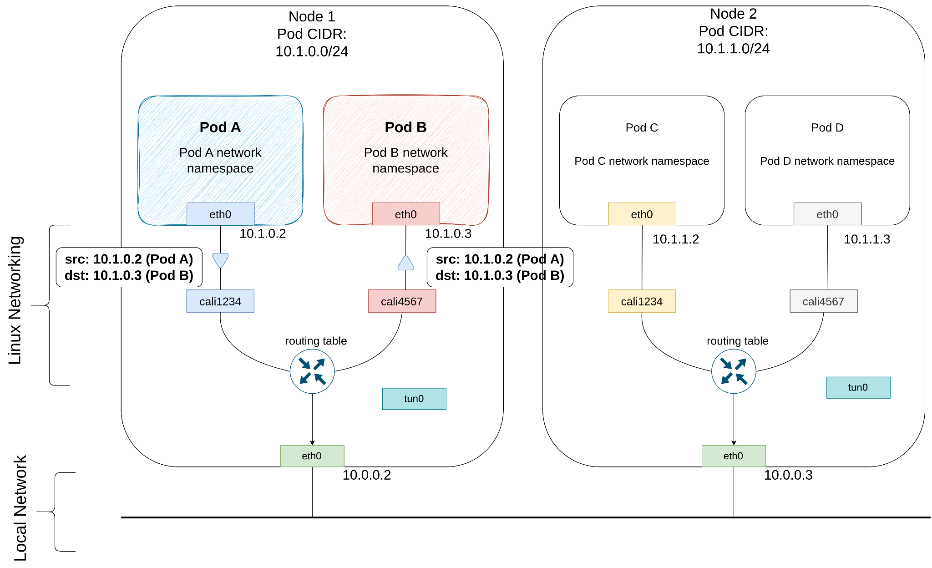
Pod to Pod networking: Same Node

Slide 53
Pod to Pod networking: Different nodes

Slide 54
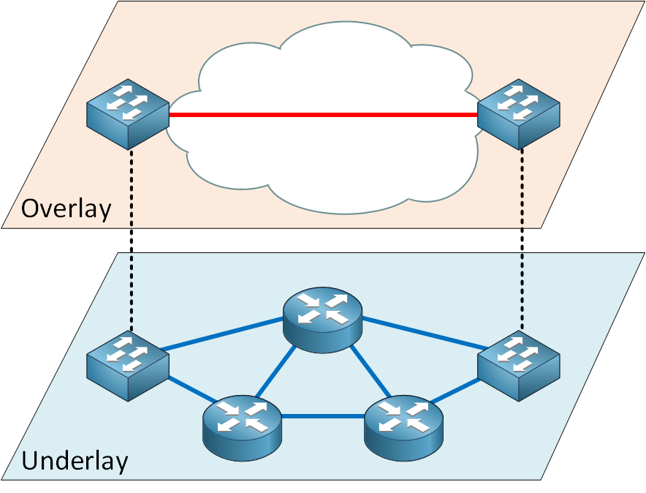
Overlay network
Virtual network running on top of a physical network (called underlay network)
Overlay for pods
Underlay for nodes

Slide 55
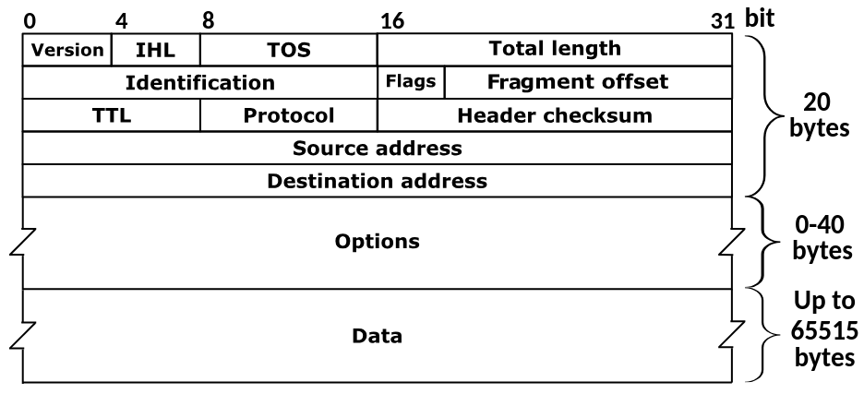
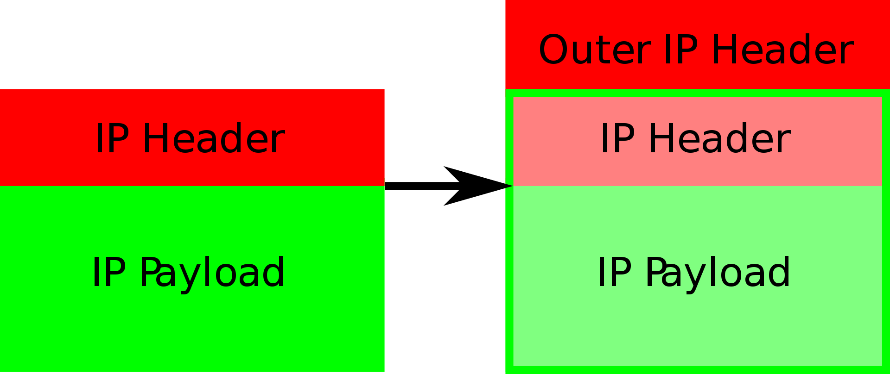
Ip in Ip
IP tunneling protocol
Encapsulate one IP packet in another IP packet
Tunnel entry does the encapsulation
Tunnel end does the decapsulation
IP packet structure

Slide 56
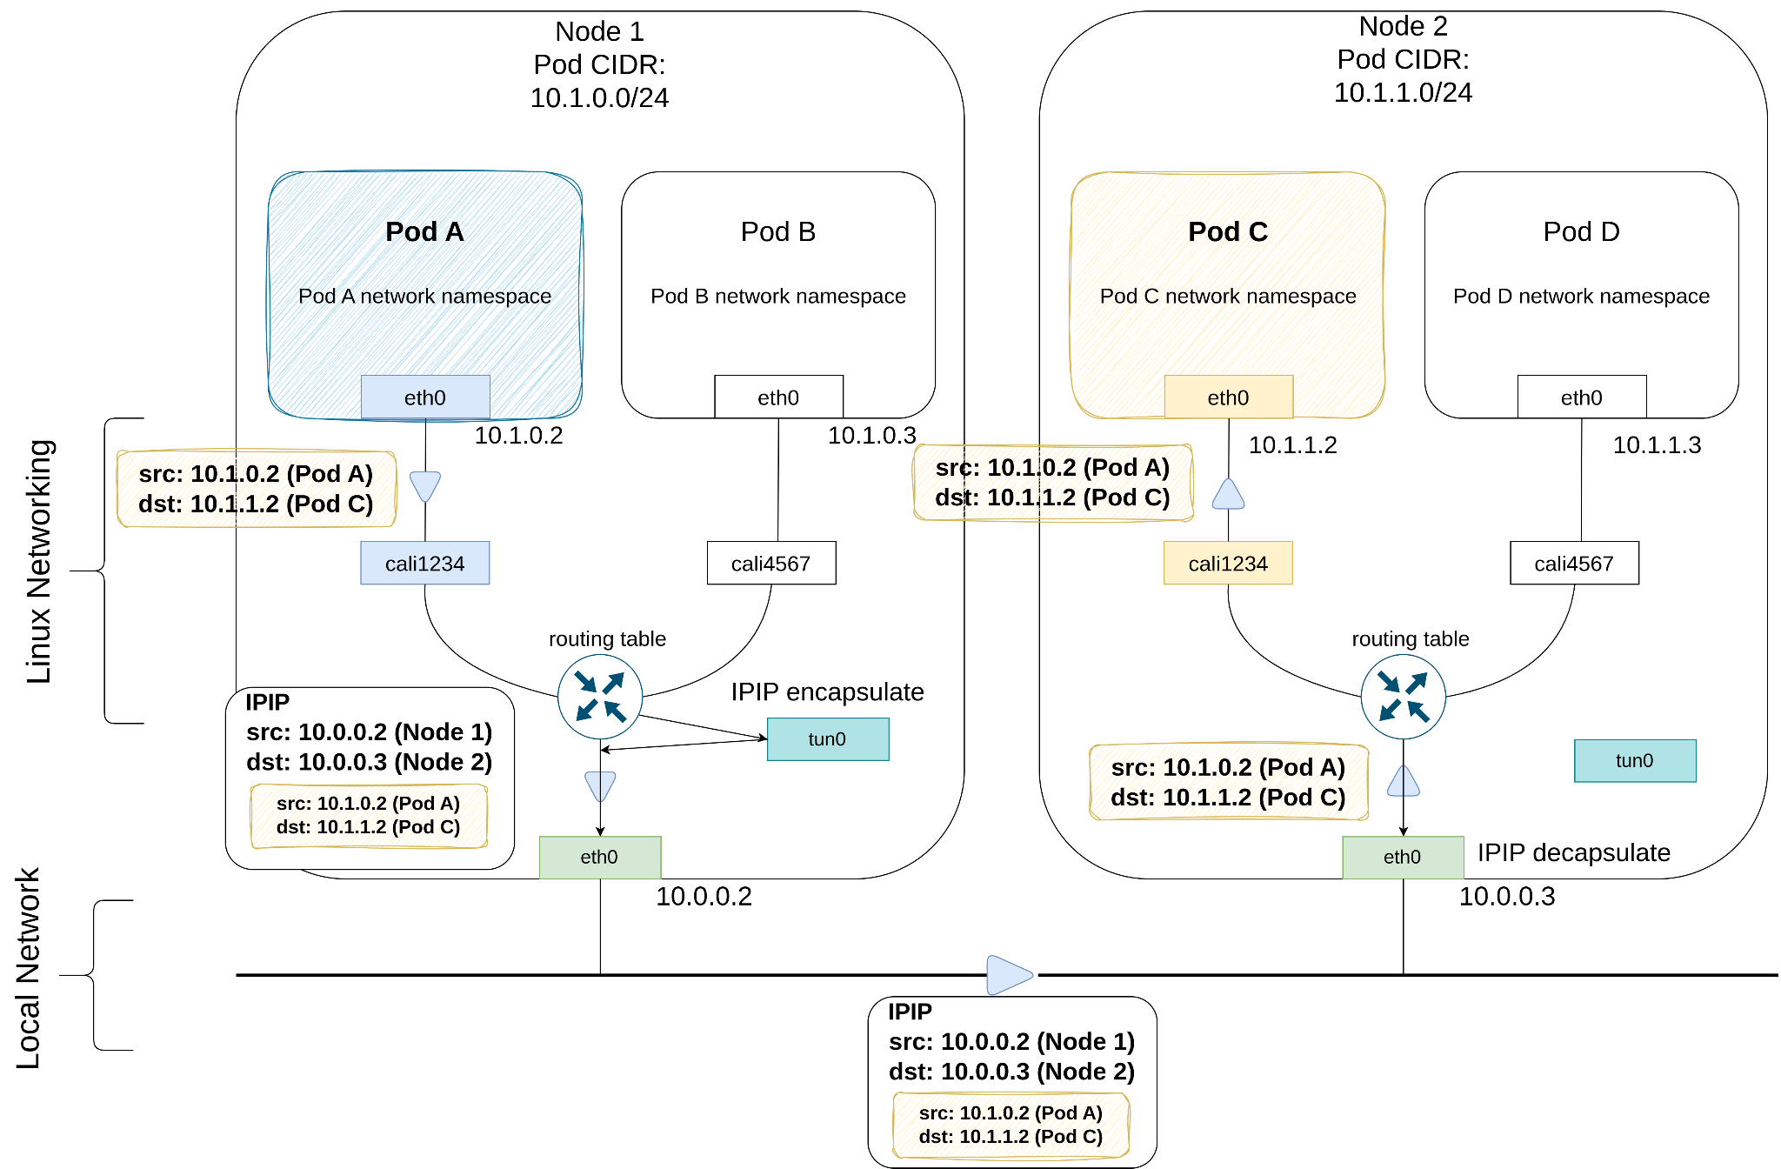
Pod to Pod networking: Different Nodes

Slide 57
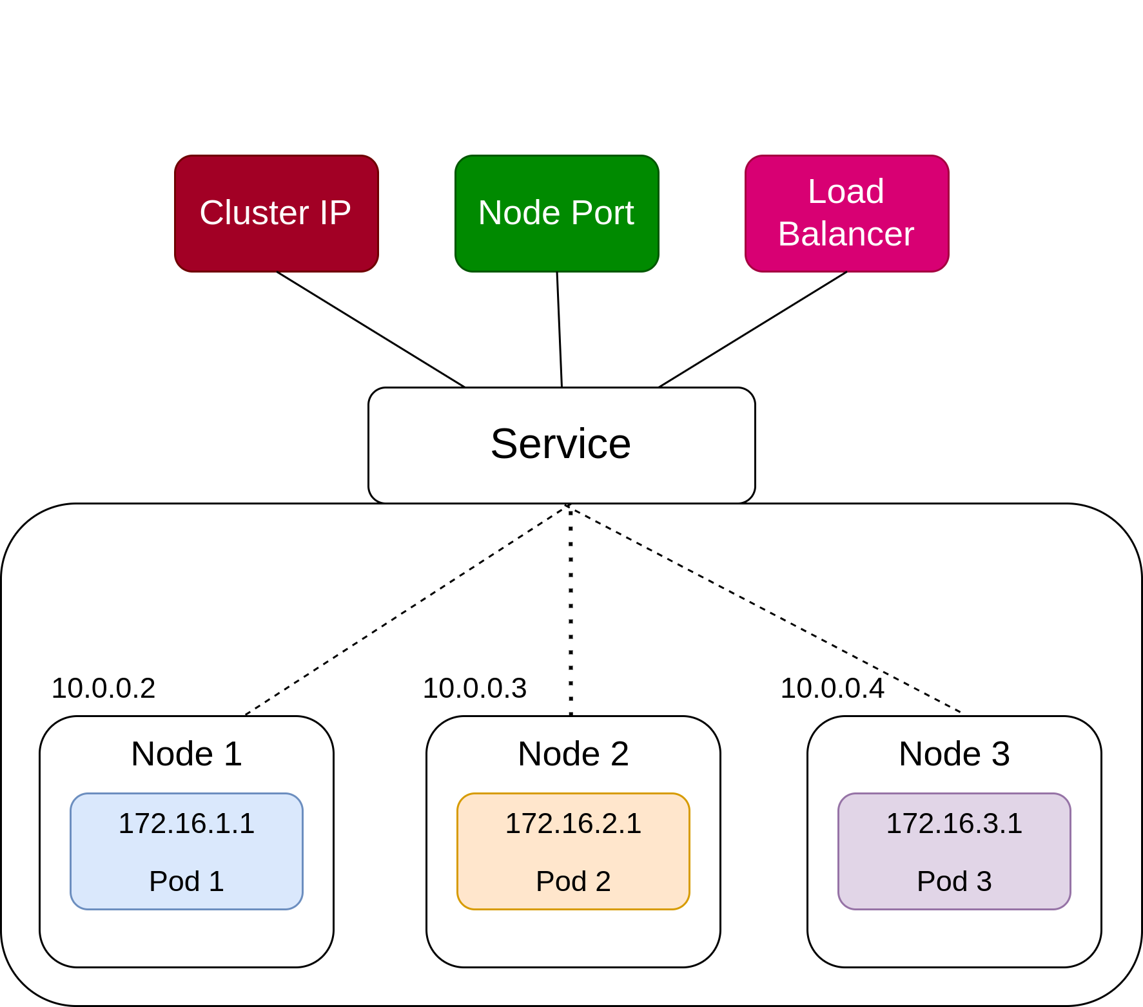
K8s services overview
A service balances load between pods
Cluster IP
Service gets a virtual ip
NodePort
Listen on a port on all nodes
Based on ClusterIP internally

Slide 58
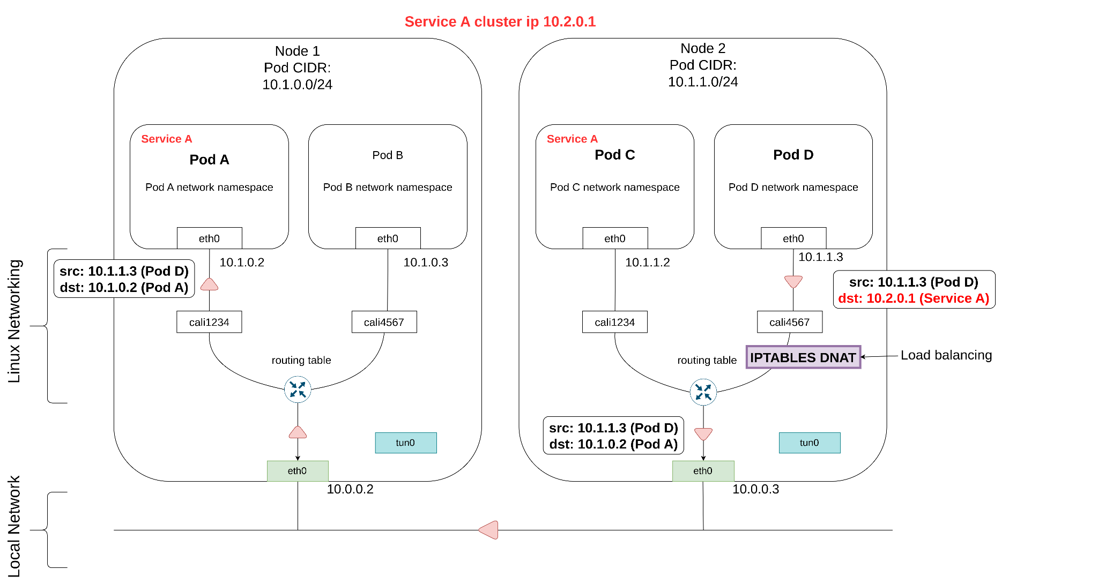
ClusterIP request

Slide 60
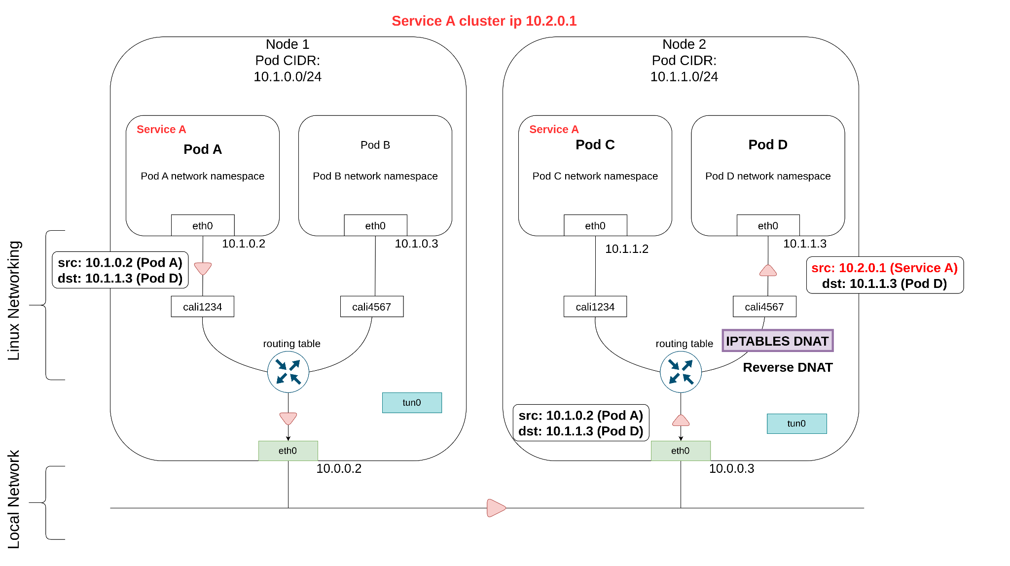
ClusterIP response

Slide 61
DNS

Slide 62
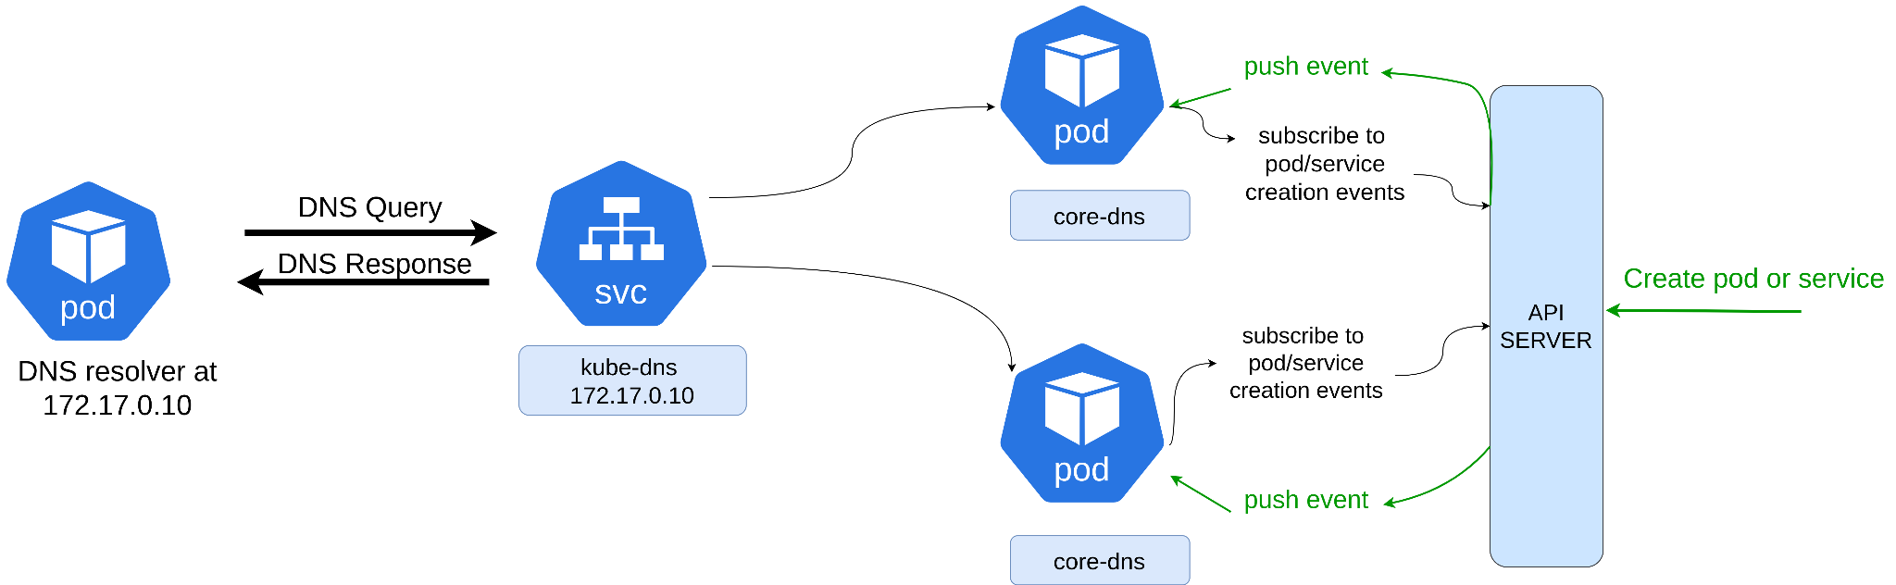
K8s dns
Each pod has a dns resolver in /etc/resolv.conf
The resolver points to ClusterIP of kube-dns service
Core-dns pods consult the service registry
Service registry contains mapping of service names to pod ips

Slide 63
Agenda
Some basics ✅
OSI ✅
NIC ✅
Routing ✅
NAT ✅
Network namespaces ✅
Veth pairs ✅
Virtual bridges ✅
IPTABLES ✅
K8s ✅
Architecture ✅
Pod to Pod networking ✅
Service networking ✅
DNS ✅

Slide 64
Recap

Slide 65
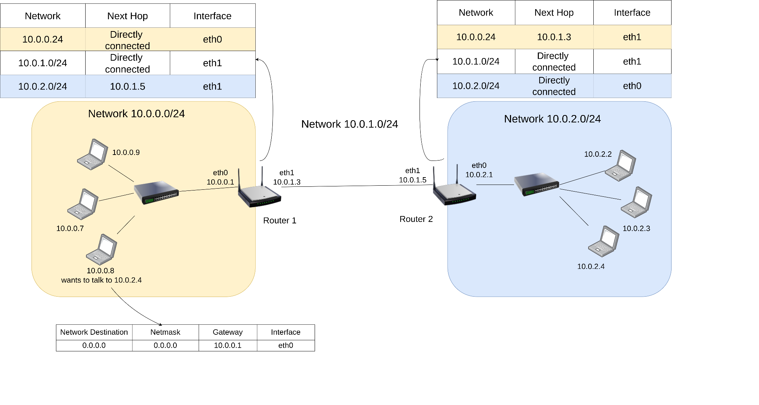

Slide 68
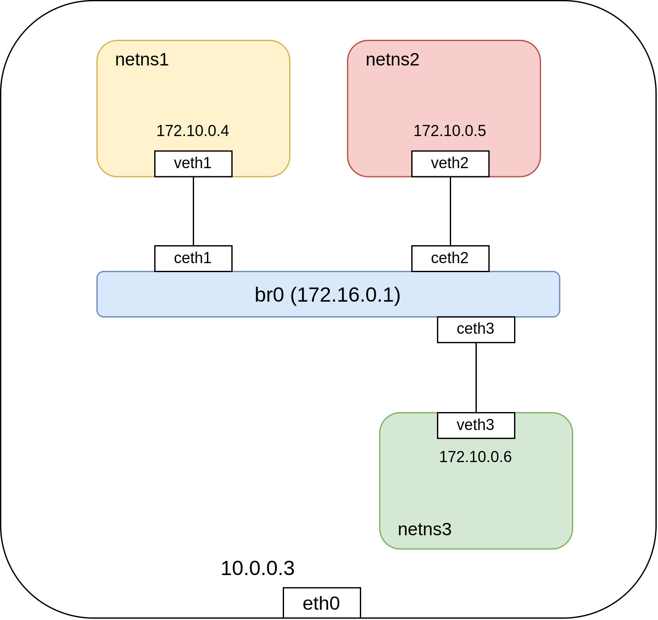

Slide 70
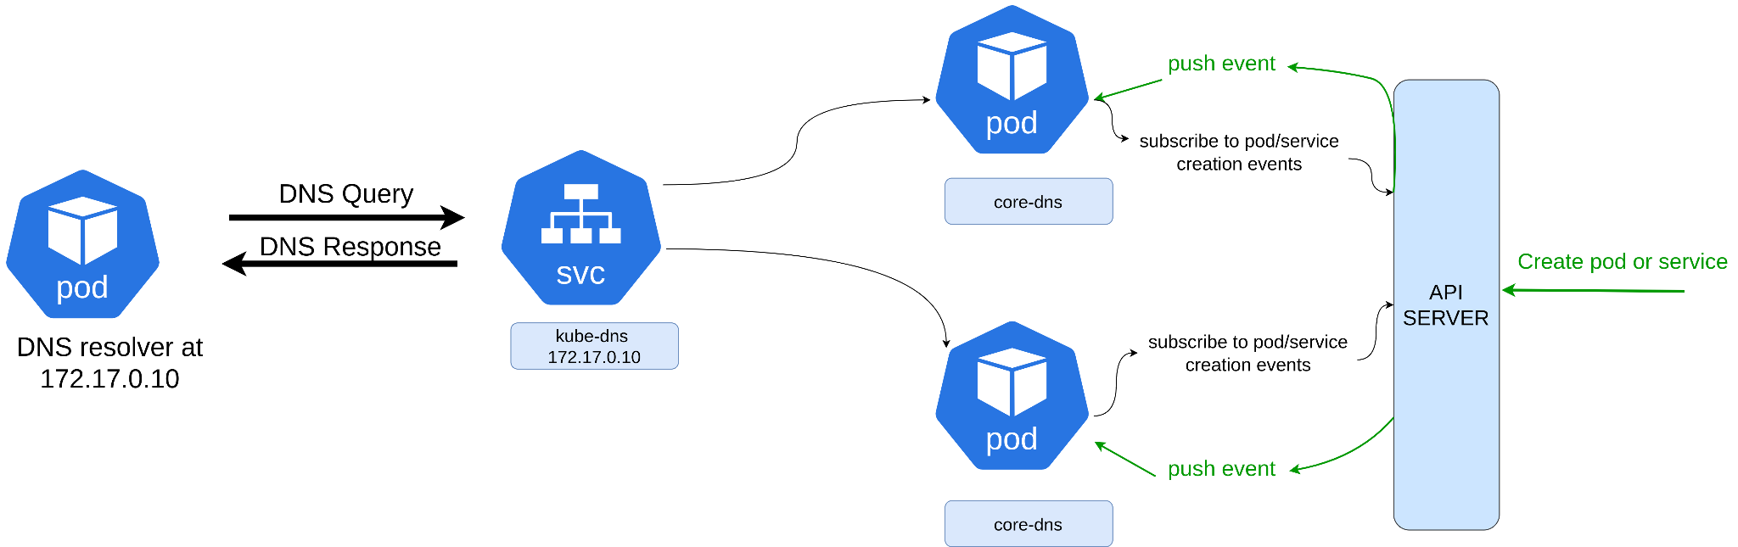

Slide 71
Thank you

